Slide 1

WSQ PROFESSIONAL COURSE
Generative AI for Finance and Fintech
From governed insight to controlled finance action
TGS-2026065050 · ACC-ICT-5004-1.1
Tertiary Infotech Academy Pte Ltd v4.0 · 23 August 2026
TGS-2026065050 • Tertiary Infotech Academy Pte Ltd
1

Slide 2
COURSE ORIENTATION
Welcome and digital attendance
WHY IT MATTERS
01
Confirm your registered name
Decision principle
Scan the attendance QR code shown by your trainer. Keep the LMS open for learning evidence.
02
Mark attendance at the required checkpoints
03
Ask the trainer if your record does not appear
TGS-2026065050 • Tertiary Infotech Academy Pte Ltd
2

Slide 3
COURSE ORIENTATION
Meet your trainer
WHY IT MATTERS
01
Connect technical capabilities to business controls
Decision principle
Dr. Alfred Ang facilitates the course as a finance-AI decision and governance workshop.
02
Challenge assumptions with evidence
03
Keep learner and assessment data confidential
TGS-2026065050 • Tertiary Infotech Academy Pte Ltd
3

Slide 4
COURSE ORIENTATION
How we will work
WHY IT MATTERS
01
Question claims and reconcile numbers
Decision principle
The class alternates between visual concepts, decision conversations and evidence-led labs.
02
Use synthetic data in the learning environment
03
Share reasoning without sharing credentials
TGS-2026065050 • Tertiary Infotech Academy Pte Ltd
4

Slide 5
COURSE ORIENTATION
Learning environment
WHY IT MATTERS
01
Slides explain concepts and decisions
Decision principle
All detailed procedures live in the Learner Guide and each lab folder.
02
Labs contain starter data and acceptance checks
03
LMS receives only learner-facing assessment papers
TGS-2026065050 • Tertiary Infotech Academy Pte Ltd
5

Slide 6
COURSE ORIENTATION
Four-day journey
WHY IT MATTERS
01
Day 1: foundations and opportunity portfolio
Decision principle
Build understanding, apply finance copilots, orchestrate agents, then secure and govern them.
02
Day 2: Copilot in Excel and Finance Agent
03
Day 3: Microsoft 365 Copilot and Copilot Studio
04
Day 4: risk, security, fraud, roadmap and assessment
TGS-2026065050 • Tertiary Infotech Academy Pte Ltd
6

Slide 7
COURSE ORIENTATION
Skills framework alignment
WHY IT MATTERS
01
Knowledge: K1–K4
Decision principle
ACC-ICT-5004-1.1 · Digital Technology Adoption and Innovation
02
Abilities: A1–A5
03
Evidence: 10 connected labs plus two assessments
TGS-2026065050 • Tertiary Infotech Academy Pte Ltd
7

Slide 8
COURSE ORIENTATION
Learning outcomes
WHY IT MATTERS
01
LO1: Support Artificial Intelligence (AI) and Generative AI innovations to champion organisation-wide innovation.
Decision principle
By the end, you can support, evaluate, adopt, govern and economically scale finance AI.
02
LO2: Evaluate and implement GAI technologies for the organisation.
03
LO3: Review and adopt new GAI technologies by reviewing use cases in finance operations.
04
LO4: Review AI ethics and governance in organisation processes for proactive risk monitoring and safety.
05
LO5: Review emerging trends in GAI and strategise cost-control measures to support innovation initiatives.
TGS-2026065050 • Tertiary Infotech Academy Pte Ltd
8

Slide 9
COURSE ORIENTATION
Assessment architecture
WHY IT MATTERS
01
Written Assessment (SAQ): 4 open-ended questions · 60 minutes
Decision principle
Assessment samples the same judgement and evidence practised in the labs.
02
Case Study: 5 integrated tasks · 60 minutes
03
Open book; no practice examination
04
Written items map to K2/K1/K3/K4; case tasks map to A1–A5
TGS-2026065050 • Tertiary Infotech Academy Pte Ltd
9

Slide 10
COURSE ORIENTATION
Evidence standard
WHY IT MATTERS
01
Use the supplied scenario and data
Decision principle
A strong answer is traceable, reconciled, controlled and decision-ready.
02
State assumptions explicitly
03
Show formulas, tests or control evidence
04
Name the accountable reviewer and escalation path
TGS-2026065050 • Tertiary Infotech Academy Pte Ltd
10

Slide 11
COURSE ORIENTATION · FACILITATOR ROLE
Trainer profile template
TRAINER
EXPERIENCE
CAPABILITY
Finance and fintech practice
AI facilitation capability
Relevant experience in finance operations, analytics, risk, governance or technology adoption.
Can demonstrate copilots and agents while keeping evidence, privacy, security and accountability visible.
BOUNDARY
LEARNING
Assessment role
Learner support
Explains evidence standards without coaching answers.
Creates a safe environment for questions, peer review and escalation.
TGS-2026065050 • Tertiary Infotech Academy Pte Ltd
11

Slide 12
COURSE ORIENTATION · VISUAL LEARNER JOURNEY
Download course material
1
2
3
4
5
01
02
03
04
05
Sign in to LMS-TMS
Open your enrolled course
Select course material
Download the learner files
Confirm the lab folders open
Accountability and evidence travel with the work
TGS-2026065050 • Tertiary Infotech Academy Pte Ltd
12

Slide 13
COURSE ORIENTATION · EVIDENCE PATH
Assessment flow and sign-off
1
2
3
4
WA · SAQ
Case Study
Assessor review
Candidate sign-off
4 open-ended responses Knowledge K2/K1/K3/K4
5 integrated tasks Abilities A1–A5
Evidence and criteria C / NYC decision
Feedback and acknowledgement Final record
Open book · two controlled instruments · no practice examination
TGS-2026065050 • Tertiary Infotech Academy Pte Ltd
13

Slide 14
TOPIC 01
Introduction to Generative AI and Its Foundations in Finance
AI, machine learning, GenAI, agents, finance value chains and responsible innovation
01
Competency focus K2 · A1
TGS-2026065050 • Tertiary Infotech Academy Pte Ltd
14

Slide 15
TOPIC 1 · CONCEPT
AI, ML, GenAI and agents
These are nested capabilities, not interchangeable labels.
1
2
3
4
01
02
03
04
AI performs tasks associated with intelligence
Machine learning learns patterns from data
Generative AI creates or transforms content
Agents pursue goals by selecting knowledge and tools
TGS-2026065050 • Tertiary Infotech Academy Pte Ltd
15

Slide 16
TOPIC 1 · CONCEPT
The finance decision loop
Finance AI creates value only when insight changes an accountable decision.
1
2
3
4
01
02
03
04
Observe transactions and business drivers
Interpret signals in financial context
Recommend or execute a bounded action
Record evidence, approvals and outcomes
TGS-2026065050 • Tertiary Infotech Academy Pte Ltd
16

Slide 17
TOPIC 1 · CONCEPT
Generative versus predictive AI
Prediction estimates what may happen; generation explains, drafts or synthesises.
1
2
3
4
01
02
03
04
Credit default probability is predictive
A variance narrative is generative
Fraud triage often combines both
Controls differ by impact and autonomy
TGS-2026065050 • Tertiary Infotech Academy Pte Ltd
17

Slide 18
TOPIC 1 · CONCEPT
Agentic AI anatomy
A useful agent is a governed system of instructions, knowledge, tools and memory.
1
2
3
4
01
02
03
04
Instructions define purpose and boundaries
Knowledge grounds answers
Tools perform permitted actions
Identity and memory preserve context safely
TGS-2026065050 • Tertiary Infotech Academy Pte Ltd
18

Slide 19
TOPIC 1 · CONCEPT
Single-agent versus multi-agent
Specialisation can improve clarity, but orchestration adds failure modes.
1
2
3
4
01
02
03
04
Single agents are simpler to test
Multi-agent systems separate roles
Handoffs need contracts and logs
A supervisor agent must not become an unbounded approver
TGS-2026065050 • Tertiary Infotech Academy Pte Ltd
19

Slide 20
TOPIC 1 · CONCEPT
Where finance creates value
The strongest early uses reduce repetitive analysis while preserving judgement.
1
2
3
4
01
02
03
04
Close and reconciliation
Planning and variance analysis
Collections and working capital
Risk, compliance and audit support
TGS-2026065050 • Tertiary Infotech Academy Pte Ltd
20

Slide 21
TOPIC 1 · CONCEPT
Three horizons of adoption
Assist, automate and transform require progressively stronger controls.
1
2
3
4
01
02
03
04
Assist: draft and analyse
Automate: execute repeatable bounded steps
Transform: redesign end-to-end work
Autonomy rises only with evidence
TGS-2026065050 • Tertiary Infotech Academy Pte Ltd
21

Slide 22
TOPIC 1 · CONCEPT
Data grounding
Finance answers must be tied to authoritative, dated and permissioned sources.
1
2
3
4
01
02
03
04
Use controlled workbooks and ERP extracts
Retain source links and as-of dates
Separate facts from assumptions
Do not infer missing accounting policy
TGS-2026065050 • Tertiary Infotech Academy Pte Ltd
22

Slide 23
TOPIC 1 · CONCEPT
Prompt contracts for finance
A strong prompt names the role, task, data boundary, controls and output schema.
1
2
3
4
01
02
03
04
State the finance objective
Define allowed sources
Require reconciliations and caveats
Specify tables, units and review status
TGS-2026065050 • Tertiary Infotech Academy Pte Ltd
23

Slide 24
TOPIC 1 · CONCEPT
Human accountability
AI can prepare and recommend; accountable people approve material finance decisions.
1
2
3
4
01
02
03
04
Define preparer and reviewer roles
Set monetary and risk thresholds
Require evidence for overrides
Escalate ambiguity rather than fabricate
TGS-2026065050 • Tertiary Infotech Academy Pte Ltd
24

Slide 25
TOPIC 1 · CONCEPT
Innovation portfolio
Select use cases by value, feasibility, controlability and learning speed.
1
2
3
4
01
02
03
04
Prioritise low-risk high-frequency work
Avoid consumer-impact decisions as first pilots
Measure baseline before automation
Design an exit path and fallback
TGS-2026065050 • Tertiary Infotech Academy Pte Ltd
25

Slide 26
TOPIC 1 · CONCEPT
Responsible experimentation
A sandbox is a control boundary, not a licence to upload sensitive data.
1
2
3
4
01
02
03
04
Use synthetic or masked data
Restrict connectors
Log prompt and output tests
Promote through governed environments
TGS-2026065050 • Tertiary Infotech Academy Pte Ltd
26

Slide 27
TOPIC 1 · FINANCE USE CASE
Accounts payable invoice triage
CONTROLLERSHIP
OUTCOME
GOVERNED DESIGN
Operating pattern
Value hypothesis
Control and evidence
Route invoices, detect missing fields and draft exception notes
Lower handling time
Three-way match, duplicate rules, reviewer approval Measure: Touchless rate · exception ageing
FAILURE MODE
Primary risk
Invoice fraud and duplicate payments
TGS-2026065050 • Tertiary Infotech Academy Pte Ltd
27

Slide 28
TOPIC 1 · USE CASE CONTROL
Accounts payable invoice triage: control cockpit
1
2
3
4
Trigger
Grounding
Guardrail
Exception
A dated business event enters the workflow.
Route invoices, detect missing fields and draft exception notes
Three-way match, duplicate rules, reviewer approval
Invoice fraud and duplicate payments
KPI Touchless rate · exception ageing • Pattern source: Microsoft finance scenario library
TGS-2026065050 • Tertiary Infotech Academy Pte Ltd
28

Slide 29
TOPIC 1 · FINANCE USE CASE
Cash application
WORKING CAPITAL
OUTCOME
GOVERNED DESIGN
Operating pattern
Value hypothesis
Control and evidence
Match remittances to open invoices and explain residuals
Faster posting
Tolerance rules, customer key validation, audit trail Measure: Auto-match rate · unapplied cash
FAILURE MODE
Primary risk
Incorrect customer allocation
TGS-2026065050 • Tertiary Infotech Academy Pte Ltd
29

Slide 30
TOPIC 1 · USE CASE CONTROL
Cash application: control cockpit
1
2
3
4
Trigger
Grounding
Guardrail
Exception
A dated business event enters the workflow.
Match remittances to open invoices and explain residuals
Tolerance rules, customer key validation, audit trail
Incorrect customer allocation
KPI Auto-match rate · unapplied cash • Pattern source: Microsoft finance scenario library
TGS-2026065050 • Tertiary Infotech Academy Pte Ltd
30

Slide 31
TOPIC 1 · FINANCE USE CASE
Collections prioritisation
WORKING CAPITAL
OUTCOME
GOVERNED DESIGN
Operating pattern
Value hypothesis
Control and evidence
Rank overdue accounts and draft context-aware outreach
Improved DSO
Approved templates and human send approval Measure: Promise-to-pay rate · DSO
FAILURE MODE
Primary risk
Unfair or inappropriate communication
TGS-2026065050 • Tertiary Infotech Academy Pte Ltd
31

Slide 32
TOPIC 1 · USE CASE CONTROL
Collections prioritisation: control cockpit
1
2
3
4
Trigger
Grounding
Guardrail
Exception
A dated business event enters the workflow.
Rank overdue accounts and draft context-aware outreach
Approved templates and human send approval
Unfair or inappropriate communication
KPI Promise-to-pay rate · DSO • Pattern source: Microsoft Finance Agent
TGS-2026065050 • Tertiary Infotech Academy Pte Ltd
32

Slide 33
TOPIC 1 · FINANCE USE CASE
Expense policy assistant
CONTROLLERSHIP
OUTCOME
GOVERNED DESIGN
Operating pattern
Value hypothesis
Control and evidence
Answer employee expense questions from approved policy
Fewer queries
Effective-date citations and escalation Measure: First-contact resolution
FAILURE MODE
Primary risk
Outdated or unauthorised advice
TGS-2026065050 • Tertiary Infotech Academy Pte Ltd
33

Slide 34
TOPIC 1 · USE CASE CONTROL
Expense policy assistant: control cockpit
1
2
3
4
Trigger
Grounding
Guardrail
Exception
A dated business event enters the workflow.
Answer employee expense questions from approved policy
Effective-date citations and escalation
Outdated or unauthorised advice
KPI First-contact resolution • Pattern source: Microsoft Copilot Studio
TGS-2026065050 • Tertiary Infotech Academy Pte Ltd
34

Slide 35
TOPIC 1 · FINANCE USE CASE
Regulatory filing summarisation
COMPLIANCE
OUTCOME
GOVERNED DESIGN
Operating pattern
Value hypothesis
Control and evidence
Extract obligations and draft a review checklist
Faster interpretation
Primary-source citations and legal review Measure: Review hours · citation accuracy
FAILURE MODE
Primary risk
Hallucinated requirement
TGS-2026065050 • Tertiary Infotech Academy Pte Ltd
35

Slide 36
TOPIC 1 · USE CASE CONTROL
Regulatory filing summarisation: control cockpit
1
2
3
4
Trigger
Grounding
Guardrail
Exception
A dated business event enters the workflow.
Extract obligations and draft a review checklist
Primary-source citations and legal review
Hallucinated requirement
KPI Review hours · citation accuracy • Pattern source: US Treasury AI report
TGS-2026065050 • Tertiary Infotech Academy Pte Ltd
36

Slide 37
TOPIC 1 · FINANCE USE CASE
Earnings-call preparation
FP&A
OUTCOME
GOVERNED DESIGN
Operating pattern
Value hypothesis
Control and evidence
Synthesize performance drivers and likely stakeholder questions
Better preparation
Reconcile to approved results and disclosures Measure: Prep cycle time · corrections
FAILURE MODE
Primary risk
Selective or misleading narrative
TGS-2026065050 • Tertiary Infotech Academy Pte Ltd
37

Slide 38
TOPIC 1 · USE CASE CONTROL
Earnings-call preparation: control cockpit
1
2
3
4
Trigger
Grounding
Guardrail
Exception
A dated business event enters the workflow.
Synthesize performance drivers and likely stakeholder questions
Reconcile to approved results and disclosures
Selective or misleading narrative
KPI Prep cycle time · corrections • Pattern source: AFP use cases
TGS-2026065050 • Tertiary Infotech Academy Pte Ltd
38

Slide 39
TOPIC 1 · FINANCE USE CASE
Treasury liquidity briefing
TREASURY
OUTCOME
GOVERNED DESIGN
Operating pattern
Value hypothesis
Control and evidence
Summarise cash, facilities and forecast risks
Faster visibility
As-of timestamps and source reconciliation Measure: Forecast error · liquidity headroom
FAILURE MODE
Primary risk
Stale balances
TGS-2026065050 • Tertiary Infotech Academy Pte Ltd
39

Slide 40
TOPIC 1 · USE CASE CONTROL
Treasury liquidity briefing: control cockpit
1
2
3
4
Trigger
Grounding
Guardrail
Exception
A dated business event enters the workflow.
Summarise cash, facilities and forecast risks
As-of timestamps and source reconciliation
Stale balances
KPI Forecast error · liquidity headroom • Pattern source: Industry pattern
TGS-2026065050 • Tertiary Infotech Academy Pte Ltd
40

Slide 41
TOPIC 1 · FINANCE USE CASE
Credit memo drafting
LENDING
OUTCOME
GOVERNED DESIGN
Operating pattern
Value hypothesis
Control and evidence
Assemble borrower facts and analyst rationale
Analyst productivity
Reason codes, source citations, credit approval Measure: Turnaround · override rate
FAILURE MODE
Primary risk
Bias and unsupported conclusions
TGS-2026065050 • Tertiary Infotech Academy Pte Ltd
41

Slide 42
TOPIC 1 · USE CASE CONTROL
Credit memo drafting: control cockpit
1
2
3
4
Trigger
Grounding
Guardrail
Exception
A dated business event enters the workflow.
Assemble borrower facts and analyst rationale
Reason codes, source citations, credit approval
Bias and unsupported conclusions
KPI Turnaround · override rate • Pattern source: US Treasury AI report
TGS-2026065050 • Tertiary Infotech Academy Pte Ltd
42

Slide 43
TOPIC 1 · FINANCE USE CASE
Insurance claims summarisation
INSURANCE
OUTCOME
GOVERNED DESIGN
Operating pattern
Value hypothesis
Control and evidence
Summarise documents and flag inconsistencies
Faster triage
Access control, human adjudication, appeal Measure: Cycle time · rework
FAILURE MODE
Primary risk
Sensitive-data leakage and wrongful denial
TGS-2026065050 • Tertiary Infotech Academy Pte Ltd
43

Slide 44
TOPIC 1 · USE CASE CONTROL
Insurance claims summarisation: control cockpit
1
2
3
4
Trigger
Grounding
Guardrail
Exception
A dated business event enters the workflow.
Summarise documents and flag inconsistencies
Access control, human adjudication, appeal
Sensitive-data leakage and wrongful denial
KPI Cycle time · rework • Pattern source: US Treasury AI report
TGS-2026065050 • Tertiary Infotech Academy Pte Ltd
44

Slide 45
TOPIC 1 · FINANCE USE CASE
Financial research synthesis
MARKETS
OUTCOME
GOVERNED DESIGN
Operating pattern
Value hypothesis
Control and evidence
Summarise filings, transcripts and macro evidence
Broader coverage
Citations, as-of dates, restricted recommendation scope Measure: Source coverage · correction rate
FAILURE MODE
Primary risk
Unverified market claims
TGS-2026065050 • Tertiary Infotech Academy Pte Ltd
45

Slide 46
TOPIC 1 · USE CASE CONTROL
Financial research synthesis: control cockpit
1
2
3
4
Trigger
Grounding
Guardrail
Exception
A dated business event enters the workflow.
Summarise filings, transcripts and macro evidence
Citations, as-of dates, restricted recommendation scope
Unverified market claims
KPI Source coverage · correction rate • Pattern source: Industry pattern
TGS-2026065050 • Tertiary Infotech Academy Pte Ltd
46

Slide 47
TOPIC 1 · REAL-WORLD CASE
JPMorgan contract intelligence
EVIDENCE
CASE
What happened
Machine learning and language processing applied to high-volume contract review; use as a pattern for evidence extraction, not autonomous legal approval.
Document review
Transferable pattern
Control question
Translate the operating pattern—not the headline—into your finance context.
What evidence would justify moving from assistive output to a bounded action?
TGS-2026065050 • Tertiary Infotech Academy Pte Ltd
47

Slide 48
TOPIC 1 · REAL-WORLD CASE
OCBC AI portfolio
EVIDENCE
CASE
What happened
The legacy deck profiles customer, operations and decision-support uses; the updated lesson separates reported capability from training assumptions.
Banking
Transferable pattern
Control question
Translate the operating pattern—not the headline—into your finance context.
What evidence would justify moving from assistive output to a bounded action?
TGS-2026065050 • Tertiary Infotech Academy Pte Ltd
48

Slide 49
TOPIC 1 · REAL-WORLD CASE
Morgan Stanley knowledge assistant
EVIDENCE
CASE
What happened
A grounded assistant helps advisers navigate approved internal research while the adviser remains accountable for client advice.
Wealth management
Transferable pattern
Control question
Translate the operating pattern—not the headline—into your finance context.
What evidence would justify moving from assistive output to a bounded action?
TGS-2026065050 • Tertiary Infotech Academy Pte Ltd
49

Slide 50
TOPIC 1 · EDITABLE POWERPOINT CHART
Topic 1 · value-and-control portfolio
INTERPRET
Read the signal
Compare magnitude, exceptions and trend before generating a narrative.
REVIEW
Control the conclusion
Reconcile to source totals, verify units and distinguish fact from hypothesis.
TGS-2026065050 • Tertiary Infotech Academy Pte Ltd
50

Slide 51
TOPIC 1 · APPLIED EVIDENCE
Lab 1 · Prioritise a Finance AI Use-Case Portfolio
K2 · A1
90 MINUTES
SUBMIT
Scenario
Objective
Evidence
Northstar Finance is selecting its first governed AI pilots across FP&A, controllership, treasury, risk and customer operations.
Score finance AI opportunities by value, feasibility, risk and learning speed.
A prioritised portfolio and one-page pilot charter. Acceptance: Weights total 100%; every shortlisted use case has a named owner, baseline KPI, risk tier and stop condition.
TGS-2026065050 • Tertiary Infotech Academy Pte Ltd
51

Slide 52
TOPIC 1 · LAB OVERVIEW
Lab 1 · evidence journey
1
2
3
4
5
01
02
03
04
05
Review the synthetic use-case backlog and confirm the scoring definitions
Use the weighted scoring sheet to rank initiatives
Challenge the top three for data, control and adoption constraints
Select one pilot and complete the charter with owner, scope, baseline, KPI and stop condition
Peer-review the decision and record unresolved evidence
Accountability and evidence travel with the work
TGS-2026065050 • Tertiary Infotech Academy Pte Ltd
52

Slide 53
TOPIC 02
Excel Copilot for Finance Planning and Analysis
Data readiness, formulas, dashboards, FP&A, variance analysis, reconciliation and controls
02
Competency focus K1 · A2
TGS-2026065050 • Tertiary Infotech Academy Pte Ltd
53

Slide 54
TOPIC 2 · CONCEPT
Copilot in Excel today
Copilot edits native Excel objects so the result remains reviewable and editable.
1
2
3
4
01
02
03
04
Works with tables, formulas and cell ranges
Creates charts and PivotTables
Supports edit, plan and chat modes
Can complete multi-step workbook tasks
TGS-2026065050 • Tertiary Infotech Academy Pte Ltd
54

Slide 55
TOPIC 2 · CONCEPT
Finance Agent surfaces
Finance Agent brings purpose-built processes into Excel, Outlook and Microsoft Copilot.
1
2
3
4
01
02
03
04
Excel: reconciliation and variance analysis
Outlook: collections context and communication
Copilot: central finance insights
ERP and FP&A connectivity varies by configuration
TGS-2026065050 • Tertiary Infotech Academy Pte Ltd
55

Slide 56
TOPIC 2 · CONCEPT
Workbook readiness
Reliable AI analysis starts with a flat, typed, labelled table.
1
2
3
4
01
02
03
04
One row per business event
Stable headers without merged cells
Dates and currencies stored as real values
Unique keys and clear dimensions
TGS-2026065050 • Tertiary Infotech Academy Pte Ltd
56

Slide 57
TOPIC 2 · CONCEPT
Table design for finance
Structure determines whether formulas and AI explanations reconcile.
1
2
3
4
01
02
03
04
Separate source, assumptions and outputs
Use Excel Tables and structured references
Protect key formulas
Document units and sign conventions
TGS-2026065050 • Tertiary Infotech Academy Pte Ltd
57

Slide 58
TOPIC 2 · CONCEPT
Plan, edit or chat
Choose the least invasive Copilot mode that meets the task.
1
2
3
4
01
02
03
04
Chat for read-only exploration
Plan to review an intended approach
Edit for bounded workbook changes
Review changes before acceptance
TGS-2026065050 • Tertiary Infotech Academy Pte Ltd
58

Slide 59
TOPIC 2 · CONCEPT
Formula generation
Generated formulas are proposals that require audit like human-authored formulas.
1
2
3
4
01
02
03
04
Prefer transparent native functions
Check ranges and absolute references
Test edge cases and blanks
Reconcile totals to a control figure
TGS-2026065050 • Tertiary Infotech Academy Pte Ltd
59

Slide 60
TOPIC 2 · CONCEPT
Finance formula toolkit
A compact formula vocabulary covers much of operational analysis.
1
2
3
4
01
02
03
04
SUMIFS for controlled aggregation
XLOOKUP for mapped dimensions
IFERROR for explicit exception handling
FORECAST.LINEAR and scenario assumptions for planning
TGS-2026065050 • Tertiary Infotech Academy Pte Ltd
60

Slide 61
TOPIC 2 · CONCEPT
Dashboard design
A finance dashboard is a decision surface, not a collage of charts.
1
2
3
4
01
02
03
04
Show actual, budget and variance
Use consistent time and currency units
Expose exceptions and drivers
Link every visual to traceable source data
TGS-2026065050 • Tertiary Infotech Academy Pte Ltd
61

Slide 62
TOPIC 2 · CONCEPT
Variance analysis
Variance analysis connects a number to its business drivers and next action.
1
2
3
4
01
02
03
04
Define materiality criteria
Compare compatible periods
Identify top contributors
Generate a narrative that cites the numbers
TGS-2026065050 • Tertiary Infotech Academy Pte Ltd
62

Slide 63
TOPIC 2 · CONCEPT
Period-over-period structure
Time columns and grouping determine the meaning of MoM, QoQ and YoY comparisons.
1
2
3
4
01
02
03
04
Order periods consistently
Separate source data from PivotTable
Retain the comparison basis
Check seasonality before escalation
TGS-2026065050 • Tertiary Infotech Academy Pte Ltd
63

Slide 64
TOPIC 2 · CONCEPT
Reconciliation design
Matching is a rules-and-evidence problem before it becomes an AI problem.
1
2
3
4
01
02
03
04
Standardise keys and amounts
Define exact and tolerance matches
Separate timing from true exceptions
Record disposition and reviewer
TGS-2026065050 • Tertiary Infotech Academy Pte Ltd
64

Slide 65
TOPIC 2 · CONCEPT
Close controls
Automation should strengthen evidence for completeness, accuracy and cut-off.
1
2
3
4
01
02
03
04
Control totals before and after
Exception queues with ageing
Reviewer sign-off
Immutable activity history
TGS-2026065050 • Tertiary Infotech Academy Pte Ltd
65

Slide 66
TOPIC 2 · CONCEPT
Forecasting with Copilot
Copilot accelerates model assembly, but assumptions remain management-owned.
1
2
3
4
01
02
03
04
Start from operational drivers
Separate base, upside and downside
Use formulas instead of hard-coded outputs
Back-test against actuals
TGS-2026065050 • Tertiary Infotech Academy Pte Ltd
66

Slide 67
TOPIC 2 · CONCEPT
Scenario planning
A scenario changes coherent assumptions, not isolated cells.
1
2
3
4
01
02
03
04
Revenue volume and price
Cost inflation and productivity
Working-capital days
Funding and liquidity constraints
TGS-2026065050 • Tertiary Infotech Academy Pte Ltd
67

Slide 68
TOPIC 2 · CONCEPT
Management commentary
A useful narrative quantifies the issue, identifies a driver and names an action.
1
2
3
4
01
02
03
04
State magnitude and period
Distinguish fact from hypothesis
Name owner and due date
Avoid unsupported causal claims
TGS-2026065050 • Tertiary Infotech Academy Pte Ltd
68

Slide 69
TOPIC 2 · CONCEPT
Excel control checklist
Before sharing an AI-assisted workbook, prove structure, formulas, outputs and access.
1
2
3
4
01
02
03
04
Formula error scan
Control-total reconciliation
Sensitivity and edge-case tests
Protected source and assumption ranges
TGS-2026065050 • Tertiary Infotech Academy Pte Ltd
69

Slide 70
TOPIC 2 · FINANCE USE CASE
Budget build assistant
FP&A
OUTCOME
GOVERNED DESIGN
Operating pattern
Value hypothesis
Control and evidence
Create an editable driver-based budget structure
Faster model assembly
Formula audit and assumption register Measure: Build time · formula defects
FAILURE MODE
Primary risk
Hidden hard-codes
TGS-2026065050 • Tertiary Infotech Academy Pte Ltd
70

Slide 71
TOPIC 2 · USE CASE CONTROL
Budget build assistant: control cockpit
1
2
3
4
Trigger
Grounding
Guardrail
Exception
A dated business event enters the workflow.
Create an editable driver-based budget structure
Formula audit and assumption register
Hidden hard-codes
KPI Build time · formula defects • Pattern source: Copilot in Excel
TGS-2026065050 • Tertiary Infotech Academy Pte Ltd
71

Slide 72
TOPIC 2 · FINANCE USE CASE
Management variance analysis
FP&A
OUTCOME
GOVERNED DESIGN
Operating pattern
Value hypothesis
Control and evidence
Identify material period variances and draft drivers
Shorter reporting cycle
Materiality rules and evidence-backed narrative Measure: Close days · narrative corrections
FAILURE MODE
Primary risk
False causality
TGS-2026065050 • Tertiary Infotech Academy Pte Ltd
72

Slide 73
TOPIC 2 · USE CASE CONTROL
Management variance analysis: control cockpit
1
2
3
4
Trigger
Grounding
Guardrail
Exception
A dated business event enters the workflow.
Identify material period variances and draft drivers
Materiality rules and evidence-backed narrative
False causality
KPI Close days · narrative corrections • Pattern source: Microsoft Finance Agent
TGS-2026065050 • Tertiary Infotech Academy Pte Ltd
73

Slide 74
TOPIC 2 · FINANCE USE CASE
Balance-sheet reconciliation
CONTROLLERSHIP
OUTCOME
GOVERNED DESIGN
Operating pattern
Value hypothesis
Control and evidence
Compare account structures and generate reconciliation reports
Faster close
Deterministic rules, tolerance and reviewer sign-off Measure: Auto-match rate · aged items
FAILURE MODE
Primary risk
Incorrect matching
TGS-2026065050 • Tertiary Infotech Academy Pte Ltd
74

Slide 75
TOPIC 2 · USE CASE CONTROL
Balance-sheet reconciliation: control cockpit
1
2
3
4
Trigger
Grounding
Guardrail
Exception
A dated business event enters the workflow.
Compare account structures and generate reconciliation reports
Deterministic rules, tolerance and reviewer sign-off
Incorrect matching
KPI Auto-match rate · aged items • Pattern source: Microsoft Finance Agent
TGS-2026065050 • Tertiary Infotech Academy Pte Ltd
75

Slide 76
TOPIC 2 · FINANCE USE CASE
Intercompany matching
CONTROLLERSHIP
OUTCOME
GOVERNED DESIGN
Operating pattern
Value hypothesis
Control and evidence
Match reciprocal entries and surface entity or FX differences
Fewer unresolved items
Entity scoping and elimination controls Measure: Unmatched value · ageing
FAILURE MODE
Primary risk
Cross-entity access leakage
TGS-2026065050 • Tertiary Infotech Academy Pte Ltd
76

Slide 77
TOPIC 2 · USE CASE CONTROL
Intercompany matching: control cockpit
1
2
3
4
Trigger
Grounding
Guardrail
Exception
A dated business event enters the workflow.
Match reciprocal entries and surface entity or FX differences
Entity scoping and elimination controls
Cross-entity access leakage
KPI Unmatched value · ageing • Pattern source: Industry pattern
TGS-2026065050 • Tertiary Infotech Academy Pte Ltd
77

Slide 78
TOPIC 2 · FINANCE USE CASE
Revenue bridge
FP&A
OUTCOME
GOVERNED DESIGN
Operating pattern
Value hypothesis
Control and evidence
Decompose growth into volume, price, mix and FX
Clearer performance story
Reconciled bridge and driver definitions Measure: Unexplained variance
FAILURE MODE
Primary risk
Incorrect attribution
TGS-2026065050 • Tertiary Infotech Academy Pte Ltd
78

Slide 79
TOPIC 2 · USE CASE CONTROL
Revenue bridge: control cockpit
1
2
3
4
Trigger
Grounding
Guardrail
Exception
A dated business event enters the workflow.
Decompose growth into volume, price, mix and FX
Reconciled bridge and driver definitions
Incorrect attribution
KPI Unexplained variance • Pattern source: Industry pattern
TGS-2026065050 • Tertiary Infotech Academy Pte Ltd
79

Slide 80
TOPIC 2 · FINANCE USE CASE
Rolling forecast
FP&A
OUTCOME
GOVERNED DESIGN
Operating pattern
Value hypothesis
Control and evidence
Extend forecast from recent actuals and operational drivers
Faster reforecast
Back-testing and scenario review Measure: MAPE · bias
FAILURE MODE
Primary risk
Overfitting and stale assumptions
TGS-2026065050 • Tertiary Infotech Academy Pte Ltd
80

Slide 81
TOPIC 2 · USE CASE CONTROL
Rolling forecast: control cockpit
1
2
3
4
Trigger
Grounding
Guardrail
Exception
A dated business event enters the workflow.
Extend forecast from recent actuals and operational drivers
Back-testing and scenario review
Overfitting and stale assumptions
KPI MAPE · bias • Pattern source: Copilot in Excel
TGS-2026065050 • Tertiary Infotech Academy Pte Ltd
81

Slide 82
TOPIC 2 · FINANCE USE CASE
Headcount cost forecast
FP&A
OUTCOME
GOVERNED DESIGN
Operating pattern
Value hypothesis
Control and evidence
Model hires, attrition, salary, bonus and vacancy timing
Better workforce planning
Aggregate data and restricted payroll access Measure: Forecast error · vacancy variance
FAILURE MODE
Primary risk
Personal-data exposure
TGS-2026065050 • Tertiary Infotech Academy Pte Ltd
82

Slide 83
TOPIC 2 · USE CASE CONTROL
Headcount cost forecast: control cockpit
1
2
3
4
Trigger
Grounding
Guardrail
Exception
A dated business event enters the workflow.
Model hires, attrition, salary, bonus and vacancy timing
Aggregate data and restricted payroll access
Personal-data exposure
KPI Forecast error · vacancy variance • Pattern source: Industry pattern
TGS-2026065050 • Tertiary Infotech Academy Pte Ltd
83

Slide 84
TOPIC 2 · FINANCE USE CASE
Working-capital dashboard
TREASURY
OUTCOME
GOVERNED DESIGN
Operating pattern
Value hypothesis
Control and evidence
Visualise DSO, DPO, inventory days and cash conversion
Actionable cash view
Definitions and control totals Measure: Cash conversion cycle
FAILURE MODE
Primary risk
Metric inconsistency
TGS-2026065050 • Tertiary Infotech Academy Pte Ltd
84

Slide 85
TOPIC 2 · USE CASE CONTROL
Working-capital dashboard: control cockpit
1
2
3
4
Trigger
Grounding
Guardrail
Exception
A dated business event enters the workflow.
Visualise DSO, DPO, inventory days and cash conversion
Definitions and control totals
Metric inconsistency
KPI Cash conversion cycle • Pattern source: Industry pattern
TGS-2026065050 • Tertiary Infotech Academy Pte Ltd
85

Slide 86
TOPIC 2 · FINANCE USE CASE
Spend anomaly review
PROCUREMENT
OUTCOME
GOVERNED DESIGN
Operating pattern
Value hypothesis
Control and evidence
Highlight unusual vendor, amount or timing patterns
Leakage reduction
Risk scores as triage only Measure: Confirmed exceptions · review load
FAILURE MODE
Primary risk
False accusations
TGS-2026065050 • Tertiary Infotech Academy Pte Ltd
86

Slide 87
TOPIC 2 · USE CASE CONTROL
Spend anomaly review: control cockpit
1
2
3
4
Trigger
Grounding
Guardrail
Exception
A dated business event enters the workflow.
Highlight unusual vendor, amount or timing patterns
Risk scores as triage only
False accusations
KPI Confirmed exceptions · review load • Pattern source: Industry pattern
TGS-2026065050 • Tertiary Infotech Academy Pte Ltd
87

Slide 88
TOPIC 2 · FINANCE USE CASE
Board pack production
CFO OFFICE
OUTCOME
GOVERNED DESIGN
Operating pattern
Value hypothesis
Control and evidence
Assemble charts, narrative and actions from approved workbook
Shorter reporting cycle
Single approved source and CFO review Measure: Cycle time · revisions
FAILURE MODE
Primary risk
Disclosure inconsistency
TGS-2026065050 • Tertiary Infotech Academy Pte Ltd
88

Slide 89
TOPIC 2 · USE CASE CONTROL
Board pack production: control cockpit
1
2
3
4
Trigger
Grounding
Guardrail
Exception
A dated business event enters the workflow.
Assemble charts, narrative and actions from approved workbook
Single approved source and CFO review
Disclosure inconsistency
KPI Cycle time · revisions • Pattern source: Microsoft 365 Copilot
TGS-2026065050 • Tertiary Infotech Academy Pte Ltd
89

Slide 90
TOPIC 2 · REAL-WORLD CASE
Finance Agent reconciliation
EVIDENCE
CASE
What happened
Microsoft describes automated reconciliation reports, discrepancy suggestions and saved audit-ready summaries in Excel.
Controllership
Transferable pattern
Control question
Translate the operating pattern—not the headline—into your finance context.
What evidence would justify moving from assistive output to a bounded action?
TGS-2026065050 • Tertiary Infotech Academy Pte Ltd
90

Slide 91
TOPIC 2 · REAL-WORLD CASE
Finance Agent variance analysis
EVIDENCE
CASE
What happened
AI identifies material period variances, contributing factors and a structured narrative from flat source data and PivotTables.
FP&A
Transferable pattern
Control question
Translate the operating pattern—not the headline—into your finance context.
What evidence would justify moving from assistive output to a bounded action?
TGS-2026065050 • Tertiary Infotech Academy Pte Ltd
91

Slide 92
TOPIC 2 · EDITABLE POWERPOINT CHART
Topic 2 · value-and-control portfolio
INTERPRET
Read the signal
Compare magnitude, exceptions and trend before generating a narrative.
REVIEW
Control the conclusion
Reconcile to source totals, verify units and distinguish fact from hypothesis.
TGS-2026065050 • Tertiary Infotech Academy Pte Ltd
92

Slide 93
TOPIC 2 · APPLIED EVIDENCE
Lab 2 · Prepare Finance Data for Copilot in Excel
K1 · A2
90 MINUTES
SUBMIT
Scenario
Objective
Evidence
The FP&A team receives a mixed-quality export from the billing system and must prepare it for Copilot analysis.
Convert messy finance transactions into an analysis-ready Excel Table with control totals.
A clean transactions table, quality log and reconciled control totals. Acceptance: Duplicate count is zero, required-field errors are zero, and clean totals reconcile to the supplied control figures.
TGS-2026065050 • Tertiary Infotech Academy Pte Ltd
93

Slide 94
TOPIC 2 · LAB OVERVIEW
Lab 2 · evidence journey
1
2
3
4
5
01
02
03
04
05
Open the starter workbook and review the Data Dictionary and expected control total
Convert the source range to an Excel Table and standardise headers
Correct date, currency, account and department fields without changing transaction IDs
Use validation formulas to detect missing keys, duplicates and invalid signs
Reconcile clean revenue and expense totals to the control sheet
Accountability and evidence travel with the work
TGS-2026065050 • Tertiary Infotech Academy Pte Ltd
94

Slide 95
TOPIC 2 · APPLIED EVIDENCE
Lab 3 · Build an FP&A Formula Model and Dashboard
K1 · A2
150 MINUTES
SUBMIT
Scenario
Objective
Evidence
Northstar's CFO needs a monthly performance dashboard and a transparent base/downside forecast.
Use native finance formulas, scenarios and charts to build an auditable management dashboard.
An editable dashboard with actual, budget, variance, forecast and driver views. Acceptance: Dashboard charts remain linked to data; all formula checks pass; total variance equals actual less budget; scenarios use assumption cells rather than hard-coded outputs.
TGS-2026065050 • Tertiary Infotech Academy Pte Ltd
95

Slide 96
TOPIC 2 · LAB OVERVIEW
Lab 3 · evidence journey
1
2
3
4
5
01
02
03
04
05
Review the source Actuals, Budget and Assumptions tables
Complete SUMIFS, XLOOKUP, IFERROR, growth and margin formulas in the Analysis sheet
Build base and downside forecasts from volume, price, cost and working-capital assumptions
Create KPI tiles and native charts linked to the Analysis table
Use Copilot plan mode to propose improvements; accept only changes that preserve auditability
Accountability and evidence travel with the work
TGS-2026065050 • Tertiary Infotech Academy Pte Ltd
96

Slide 97
TOPIC 2 · APPLIED EVIDENCE
Lab 4 · Reconcile Accounts and Explain Variances
K1 · A2
120 MINUTES
SUBMIT
Scenario
Objective
Evidence
The controller must reconcile ERP and bank/ledger extracts and explain material monthly movements.
Apply deterministic matching and Finance Agent-style variance analysis to a month-end close.
A reconciliation report, exception queue and evidence-backed variance narrative. Acceptance: Matched plus exception values reconcile to each source; all unresolved items have a reason and owner; the narrative cites actual values and materiality thresholds.
TGS-2026065050 • Tertiary Infotech Academy Pte Ltd
97

Slide 98
TOPIC 2 · LAB OVERVIEW
Lab 4 · evidence journey
1
2
3
4
5
01
02
03
04
05
Review the two source tables and control totals
Apply exact, reference and tolerance match logic
Classify timing items separately from unresolved exceptions
Create the reconciliation summary and assign exception owners
Prepare a PivotTable-ready variance table with ordered periods
Accountability and evidence travel with the work
TGS-2026065050 • Tertiary Infotech Academy Pte Ltd
98

Slide 99
TOPIC 03
Practical Applications of Agentic AI to Automate Financial Processes
Finance query agents, close orchestration, collections, reporting, multi-agent design and UAT
03
Competency focus A3
TGS-2026065050 • Tertiary Infotech Academy Pte Ltd
99

Slide 100
TOPIC 3 · CONCEPT
Microsoft 365 Copilot in finance
The same grounded context can support analysis, communication and decision packs.
1
2
3
4
01
02
03
04
Excel develops evidence
Word structures the memo
PowerPoint communicates the decision
Outlook and Teams coordinate action
TGS-2026065050 • Tertiary Infotech Academy Pte Ltd
100

Slide 101
TOPIC 3 · CONCEPT
Finance query management
A Copilot Studio agent can answer policy and process questions from approved knowledge.
1
2
3
4
01
02
03
04
Ground on finance policies
Respect source permissions
Return citations and effective dates
Escalate exceptions to a human
TGS-2026065050 • Tertiary Infotech Academy Pte Ltd
101

Slide 102
TOPIC 3 · CONCEPT
Collections agent pattern
Collections combines ERP context, prioritisation and controlled communication.
1
2
3
4
01
02
03
04
Prioritise by value and ageing
Summarise account history
Draft a context-aware message
Require human approval before sending
TGS-2026065050 • Tertiary Infotech Academy Pte Ltd
102

Slide 103
TOPIC 3 · CONCEPT
Balance-sheet reconciliation agent
An agent can coordinate matching, evidence requests and reviewer handoffs.
1
2
3
4
01
02
03
04
Ingest approved extracts
Apply deterministic match rules
Explain residual exceptions
Prepare an auditable task queue
TGS-2026065050 • Tertiary Infotech Academy Pte Ltd
103

Slide 104
TOPIC 3 · CONCEPT
Copilot Studio building blocks
Knowledge, tools, topics and instructions must be designed as one control system.
1
2
3
4
01
02
03
04
Knowledge answers
Tools act
Topics handle deterministic paths
Instructions set operating boundaries
TGS-2026065050 • Tertiary Infotech Academy Pte Ltd
104

Slide 105
TOPIC 3 · CONCEPT
Agent authentication
An agent must know who is asking before retrieving or acting on finance data.
1
2
3
4
01
02
03
04
Authenticate with Microsoft Entra ID
Apply least privilege
Preserve source-level permissions
Avoid anonymous access for internal finance knowledge
TGS-2026065050 • Tertiary Infotech Academy Pte Ltd
105

Slide 106
TOPIC 3 · CONCEPT
Tools and connectors
Every connector expands both capability and data-exfiltration risk.
1
2
3
4
01
02
03
04
Classify as business, non-business or blocked
Separate read from write tools
Constrain endpoints and actions
Monitor connection ownership
TGS-2026065050 • Tertiary Infotech Academy Pte Ltd
106

Slide 107
TOPIC 3 · CONCEPT
Generative orchestration
The agent selects knowledge and tools dynamically; testing must cover unexpected routes.
1
2
3
4
01
02
03
04
Test intent ambiguity
Test tool-selection conflicts
Test unavailable dependencies
Test refusal and escalation
TGS-2026065050 • Tertiary Infotech Academy Pte Ltd
107

Slide 108
TOPIC 3 · CONCEPT
Multi-agent close
Specialist agents can prepare reconciliations, variances and commentary under a close supervisor.
1
2
3
4
01
02
03
04
Reconciliation specialist
Variance analyst
Disclosure drafter
Controller approval gate
TGS-2026065050 • Tertiary Infotech Academy Pte Ltd
108

Slide 109
TOPIC 3 · CONCEPT
Agent handoff contract
A handoff needs a structured payload, status and evidence pointer.
1
2
3
4
01
02
03
04
Task and scope
Input and source IDs
Result and confidence
Exceptions and required approval
TGS-2026065050 • Tertiary Infotech Academy Pte Ltd
109

Slide 110
TOPIC 3 · CONCEPT
UAT for finance agents
UAT proves usefulness and control performance under realistic data and edge cases.
1
2
3
4
01
02
03
04
Happy path
Missing and conflicting data
Unauthorised user
High-impact action requiring approval
TGS-2026065050 • Tertiary Infotech Academy Pte Ltd
110

Slide 111
TOPIC 3 · CONCEPT
Agent evaluation
Measure answer quality, groundedness, task completion and control adherence separately.
1
2
3
4
01
02
03
04
Correctness
Citation quality
Tool success rate
Policy violation rate
TGS-2026065050 • Tertiary Infotech Academy Pte Ltd
111

Slide 112
TOPIC 3 · CONCEPT
ALM and environments
Move agents through development, test and production with explicit approvals.
1
2
3
4
01
02
03
04
Managed solutions
Environment variables
Connection references
Release and rollback records
TGS-2026065050 • Tertiary Infotech Academy Pte Ltd
112

Slide 113
TOPIC 3 · CONCEPT
Operational monitoring
A live agent needs owners, telemetry and incident procedures.
1
2
3
4
01
02
03
04
Usage and latency
Failure and escalation rate
Data-policy alerts
Cost and capacity
TGS-2026065050 • Tertiary Infotech Academy Pte Ltd
113

Slide 114
TOPIC 3 · CONCEPT
When not to automate
Keep tasks human-led when judgement, novelty or irreversible impact dominates.
1
2
3
4
01
02
03
04
Material journal approval
Customer eligibility decisions
Regulatory interpretation
Unbounded external communication
TGS-2026065050 • Tertiary Infotech Academy Pte Ltd
114

Slide 115
TOPIC 3 · FINANCE USE CASE
Internal finance query agent
FINANCE OPERATIONS
OUTCOME
GOVERNED DESIGN
Operating pattern
Value hypothesis
Control and evidence
Answer process and policy questions with citations
Reduced support load
Authentication, source permissions and DLP Measure: Resolution · escalation
FAILURE MODE
Primary risk
Oversharing
TGS-2026065050 • Tertiary Infotech Academy Pte Ltd
115

Slide 116
TOPIC 3 · USE CASE CONTROL
Internal finance query agent: control cockpit
1
2
3
4
Trigger
Grounding
Guardrail
Exception
A dated business event enters the workflow.
Answer process and policy questions with citations
Authentication, source permissions and DLP
Oversharing
KPI Resolution · escalation • Pattern source: Microsoft scenario library
TGS-2026065050 • Tertiary Infotech Academy Pte Ltd
116

Slide 117
TOPIC 3 · FINANCE USE CASE
Close orchestration agent
CONTROLLERSHIP
OUTCOME
GOVERNED DESIGN
Operating pattern
Value hypothesis
Control and evidence
Coordinate tasks, owners, evidence and exceptions
More predictable close
Read-only by default and explicit approvals Measure: On-time tasks · reopen rate
FAILURE MODE
Primary risk
Unapproved journal or sign-off
TGS-2026065050 • Tertiary Infotech Academy Pte Ltd
117

Slide 118
TOPIC 3 · USE CASE CONTROL
Close orchestration agent: control cockpit
1
2
3
4
Trigger
Grounding
Guardrail
Exception
A dated business event enters the workflow.
Coordinate tasks, owners, evidence and exceptions
Read-only by default and explicit approvals
Unapproved journal or sign-off
KPI On-time tasks · reopen rate • Pattern source: Microsoft scenario library
TGS-2026065050 • Tertiary Infotech Academy Pte Ltd
118

Slide 119
TOPIC 3 · FINANCE USE CASE
Collections copilot
WORKING CAPITAL
OUTCOME
GOVERNED DESIGN
Operating pattern
Value hypothesis
Control and evidence
Bring ERP context into Outlook and prepare response options
Scalable outreach
Human approval and communication log Measure: DSO · response rate
FAILURE MODE
Primary risk
Automated external message risk
TGS-2026065050 • Tertiary Infotech Academy Pte Ltd
119

Slide 120
TOPIC 3 · USE CASE CONTROL
Collections copilot: control cockpit
1
2
3
4
Trigger
Grounding
Guardrail
Exception
A dated business event enters the workflow.
Bring ERP context into Outlook and prepare response options
Human approval and communication log
Automated external message risk
KPI DSO · response rate • Pattern source: Microsoft Finance Agent
TGS-2026065050 • Tertiary Infotech Academy Pte Ltd
120

Slide 121
TOPIC 3 · FINANCE USE CASE
Procure-to-pay exception agent
FINANCE OPERATIONS
OUTCOME
GOVERNED DESIGN
Operating pattern
Value hypothesis
Control and evidence
Gather missing evidence and route exceptions
Reduced queue ageing
Whitelisted actions and amount thresholds Measure: Resolution time
FAILURE MODE
Primary risk
Tool abuse
TGS-2026065050 • Tertiary Infotech Academy Pte Ltd
121

Slide 122
TOPIC 3 · USE CASE CONTROL
Procure-to-pay exception agent: control cockpit
1
2
3
4
Trigger
Grounding
Guardrail
Exception
A dated business event enters the workflow.
Gather missing evidence and route exceptions
Whitelisted actions and amount thresholds
Tool abuse
KPI Resolution time • Pattern source: Microsoft Copilot Studio
TGS-2026065050 • Tertiary Infotech Academy Pte Ltd
122

Slide 123
TOPIC 3 · FINANCE USE CASE
Tax research agent
TAX
OUTCOME
GOVERNED DESIGN
Operating pattern
Value hypothesis
Control and evidence
Retrieve internal positions and authoritative guidance
Faster research
Jurisdiction filters, effective dates, expert review Measure: Research time · citation quality
FAILURE MODE
Primary risk
Outdated or cross-jurisdiction advice
TGS-2026065050 • Tertiary Infotech Academy Pte Ltd
123

Slide 124
TOPIC 3 · USE CASE CONTROL
Tax research agent: control cockpit
1
2
3
4
Trigger
Grounding
Guardrail
Exception
A dated business event enters the workflow.
Retrieve internal positions and authoritative guidance
Jurisdiction filters, effective dates, expert review
Outdated or cross-jurisdiction advice
KPI Research time · citation quality • Pattern source: Industry pattern
TGS-2026065050 • Tertiary Infotech Academy Pte Ltd
124

Slide 125
TOPIC 3 · FINANCE USE CASE
Audit evidence assistant
AUDIT
OUTCOME
GOVERNED DESIGN
Operating pattern
Value hypothesis
Control and evidence
Index, retrieve and summarise evidence for test procedures
Reduced search time
Evidence IDs and auditor judgement Measure: Retrieval precision · gaps
FAILURE MODE
Primary risk
Evidence incompleteness
TGS-2026065050 • Tertiary Infotech Academy Pte Ltd
125

Slide 126
TOPIC 3 · USE CASE CONTROL
Audit evidence assistant: control cockpit
1
2
3
4
Trigger
Grounding
Guardrail
Exception
A dated business event enters the workflow.
Index, retrieve and summarise evidence for test procedures
Evidence IDs and auditor judgement
Evidence incompleteness
KPI Retrieval precision · gaps • Pattern source: Industry pattern
TGS-2026065050 • Tertiary Infotech Academy Pte Ltd
126

Slide 127
TOPIC 3 · FINANCE USE CASE
Disclosure checklist agent
REPORTING
OUTCOME
GOVERNED DESIGN
Operating pattern
Value hypothesis
Control and evidence
Map approved disclosures to evidence and owners
Fewer omissions
Controlled checklist and preparer/reviewer Measure: Open items · late changes
FAILURE MODE
Primary risk
Wrong reporting basis
TGS-2026065050 • Tertiary Infotech Academy Pte Ltd
127

Slide 128
TOPIC 3 · USE CASE CONTROL
Disclosure checklist agent: control cockpit
1
2
3
4
Trigger
Grounding
Guardrail
Exception
A dated business event enters the workflow.
Map approved disclosures to evidence and owners
Controlled checklist and preparer/reviewer
Wrong reporting basis
KPI Open items · late changes • Pattern source: Industry pattern
TGS-2026065050 • Tertiary Infotech Academy Pte Ltd
128

Slide 129
TOPIC 3 · FINANCE USE CASE
Investment research multi-agent
MARKETS
OUTCOME
GOVERNED DESIGN
Operating pattern
Value hypothesis
Control and evidence
Separate retrieval, financial analysis, risk challenge and writing
Traceable analysis
Handoff schemas and independent challenge Measure: Citation accuracy · disagreement rate
FAILURE MODE
Primary risk
Compounding agent errors
TGS-2026065050 • Tertiary Infotech Academy Pte Ltd
129

Slide 130
TOPIC 3 · USE CASE CONTROL
Investment research multi-agent: control cockpit
1
2
3
4
Trigger
Grounding
Guardrail
Exception
A dated business event enters the workflow.
Separate retrieval, financial analysis, risk challenge and writing
Handoff schemas and independent challenge
Compounding agent errors
KPI Citation accuracy · disagreement rate • Pattern source: Databricks investment assistant
TGS-2026065050 • Tertiary Infotech Academy Pte Ltd
130

Slide 131
TOPIC 3 · FINANCE USE CASE
Customer service banking agent
RETAIL BANKING
OUTCOME
GOVERNED DESIGN
Operating pattern
Value hypothesis
Control and evidence
Answer product and service questions using approved content
24/7 support
Scope limits and human handoff Measure: Containment · complaints
FAILURE MODE
Primary risk
Unsuitable advice
TGS-2026065050 • Tertiary Infotech Academy Pte Ltd
131

Slide 132
TOPIC 3 · USE CASE CONTROL
Customer service banking agent: control cockpit
1
2
3
4
Trigger
Grounding
Guardrail
Exception
A dated business event enters the workflow.
Answer product and service questions using approved content
Scope limits and human handoff
Unsuitable advice
KPI Containment · complaints • Pattern source: OCBC legacy case
TGS-2026065050 • Tertiary Infotech Academy Pte Ltd
132

Slide 133
TOPIC 3 · FINANCE USE CASE
Loan document review
LENDING
OUTCOME
GOVERNED DESIGN
Operating pattern
Value hypothesis
Control and evidence
Extract covenants, conditions and exceptions
Faster review
Clause-level citations and legal review Measure: Review time · missed exceptions
FAILURE MODE
Primary risk
Missed clauses
TGS-2026065050 • Tertiary Infotech Academy Pte Ltd
133

Slide 134
TOPIC 3 · USE CASE CONTROL
Loan document review: control cockpit
1
2
3
4
Trigger
Grounding
Guardrail
Exception
A dated business event enters the workflow.
Extract covenants, conditions and exceptions
Clause-level citations and legal review
Missed clauses
KPI Review time · missed exceptions • Pattern source: JPMorgan COiN pattern
TGS-2026065050 • Tertiary Infotech Academy Pte Ltd
134

Slide 135
TOPIC 3 · REAL-WORLD CASE
Finance query management
EVIDENCE
CASE
What happened
Microsoft's scenario library uses Copilot Studio to answer internal finance process questions from custom integrations and approved data.
Finance operations
Transferable pattern
Control question
Translate the operating pattern—not the headline—into your finance context.
What evidence would justify moving from assistive output to a bounded action?
TGS-2026065050 • Tertiary Infotech Academy Pte Ltd
135

Slide 136
TOPIC 3 · REAL-WORLD CASE
Collections agent
EVIDENCE
CASE
What happened
An agent combines customer and ERP context with drafted communication while retaining human accountability for external contact.
Working capital
Transferable pattern
Control question
Translate the operating pattern—not the headline—into your finance context.
What evidence would justify moving from assistive output to a bounded action?
TGS-2026065050 • Tertiary Infotech Academy Pte Ltd
136

Slide 137
TOPIC 3 · REAL-WORLD CASE
Balance-sheet reconciliation agent
EVIDENCE
CASE
What happened
An agent pattern accelerates matching, exception analysis and close evidence without removing reviewer sign-off.
Close
Transferable pattern
Control question
Translate the operating pattern—not the headline—into your finance context.
What evidence would justify moving from assistive output to a bounded action?
TGS-2026065050 • Tertiary Infotech Academy Pte Ltd
137

Slide 138
TOPIC 3 · EDITABLE POWERPOINT CHART
Topic 3 · value-and-control portfolio
INTERPRET
Read the signal
Compare magnitude, exceptions and trend before generating a narrative.
REVIEW
Control the conclusion
Reconcile to source totals, verify units and distinguish fact from hypothesis.
TGS-2026065050 • Tertiary Infotech Academy Pte Ltd
138

Slide 139
TOPIC 3 · APPLIED EVIDENCE
Lab 5 · Create a Microsoft 365 Finance Decision Pack
A3
90 MINUTES
SUBMIT
Scenario
Objective
Evidence
The CFO needs a board-ready summary and a draft response to a major overdue customer.
Turn approved Excel evidence into a controlled Word brief, PowerPoint story and collections message.
A three-part decision pack with traceable numbers and approval status. Acceptance: All repeated figures match the source workbook; facts and recommendations are separated; the external message remains a draft with an approver.
TGS-2026065050 • Tertiary Infotech Academy Pte Ltd
139

Slide 140
TOPIC 3 · LAB OVERVIEW
Lab 5 · evidence journey
1
2
3
4
5
01
02
03
04
05
Verify the approved KPI and collections tables in the workbook
Use Microsoft 365 Copilot to draft a Word decision brief with source labels
Create a concise PowerPoint narrative using only approved figures
Draft an Outlook collections message that reflects account history and policy
Mark the message as draft and route it for human approval
Accountability and evidence travel with the work
TGS-2026065050 • Tertiary Infotech Academy Pte Ltd
140

Slide 141
TOPIC 3 · APPLIED EVIDENCE
Lab 6 · Build a Grounded Finance Query Agent
A3
150 MINUTES
SUBMIT
Scenario
Objective
Evidence
Finance staff need reliable answers about expenses, close deadlines, delegation and reconciliation evidence.
Build and test a Copilot Studio agent grounded on approved finance policies.
A finance query agent, knowledge pack, test evidence and escalation design. Acceptance: The agent cites approved sources, refuses unsupported answers, respects access boundaries and passes all critical UAT cases before any publish decision.
TGS-2026065050 • Tertiary Infotech Academy Pte Ltd
141

Slide 142
TOPIC 3 · LAB OVERVIEW
Lab 6 · evidence journey
1
2
3
4
5
01
02
03
04
05
Review the supplied policy knowledge files and identify effective dates and owners
Create the agent in a governed development environment and require authentication
Write instructions that constrain answers to approved knowledge and require citations
Add a deterministic escalation topic for missing or conflicting policy
Run the positive, negative, stale-source and unauthorised-user tests in the UAT workbook
Accountability and evidence travel with the work
TGS-2026065050 • Tertiary Infotech Academy Pte Ltd
142

Slide 143
TOPIC 3 · APPLIED EVIDENCE
Lab 7 · Design and UAT a Multi-Agent Close Workflow
A3
150 MINUTES
SUBMIT
Scenario
Objective
Evidence
Northstar wants reconciliation, variance and disclosure agents coordinated by a close supervisor without autonomous journal approval.
Design a supervisor and specialist-agent workflow with structured handoffs and approval gates.
An agent architecture, handoff contract, RACI, UAT results and rollback plan. Acceptance: No agent can approve or post a journal; every handoff is structured; critical tests pass; monitoring and rollback have named owners.
TGS-2026065050 • Tertiary Infotech Academy Pte Ltd
143

Slide 144
TOPIC 3 · LAB OVERVIEW
Lab 7 · evidence journey
1
2
3
4
5
01
02
03
04
05
Map the current close process and select bounded tasks for each specialist agent
Define the supervisor's orchestration rules and human approval points
Complete the handoff schema for task, source IDs, result, confidence and exceptions
Configure or prototype the flow in Copilot Studio using read-only tools
Execute happy-path, missing-data, tool-failure and approval-bypass tests
Accountability and evidence travel with the work
TGS-2026065050 • Tertiary Infotech Academy Pte Ltd
144

Slide 145
TOPIC 04
AI Risk Management, Security and Fraud Detection
FEAT, model risk, cyber threats, identity, DLP, fraud analytics, monitoring and human oversight
04
Competency focus K3 · A4
TGS-2026065050 • Tertiary Infotech Academy Pte Ltd
145

Slide 146
TOPIC 4 · CONCEPT
Finance AI risk taxonomy
AI risk spans data, model, cyber, compliance, third-party and human use.
1
2
3
4
01
02
03
04
Data quality and leakage
Bias, hallucination and drift
Prompt injection and tool abuse
Accountability and consumer harm
TGS-2026065050 • Tertiary Infotech Academy Pte Ltd
146

Slide 147
TOPIC 4 · CONCEPT
FEAT principles
Fairness, Ethics, Accountability and Transparency form a practical finance governance lens.
1
2
3
4
01
02
03
04
Fair treatment and representative testing
Ethical purpose and proportionality
Named owners and challenge
Understandable evidence and disclosure
TGS-2026065050 • Tertiary Infotech Academy Pte Ltd
147

Slide 148
TOPIC 4 · CONCEPT
Financial Services AI RMF
Govern, map, measure and manage must be adapted to operational and consumer impact.
1
2
3
4
01
02
03
04
Govern accountability
Map use and context
Measure performance and harm
Manage controls and residual risk
TGS-2026065050 • Tertiary Infotech Academy Pte Ltd
148

Slide 149
TOPIC 4 · CONCEPT
AI system inventory
You cannot govern finance AI that has no owner, data map or deployment record.
1
2
3
4
01
02
03
04
Business purpose and tier
Model and provider
Data and connectors
Owner, reviewer and renewal date
TGS-2026065050 • Tertiary Infotech Academy Pte Ltd
149

Slide 150
TOPIC 4 · CONCEPT
Risk tiering
Control intensity should rise with autonomy, data sensitivity and decision impact.
1
2
3
4
01
02
03
04
Low: drafting and summarisation
Moderate: analysis and recommendations
High: material or customer-impact decisions
Prohibited: uncontrolled sensitive-data actions
TGS-2026065050 • Tertiary Infotech Academy Pte Ltd
150

Slide 151
TOPIC 4 · CONCEPT
Prompt injection
Untrusted content can manipulate an agent into ignoring instructions or exfiltrating data.
1
2
3
4
01
02
03
04
Treat retrieved content as data, not authority
Filter and segment sources
Constrain tools independently
Test adversarial instructions
TGS-2026065050 • Tertiary Infotech Academy Pte Ltd
151

Slide 152
TOPIC 4 · CONCEPT
Data poisoning
Corrupted training or grounding data can create persistent and plausible errors.
1
2
3
4
01
02
03
04
Track data lineage
Validate source integrity
Separate maker from approver
Monitor unexpected distribution shifts
TGS-2026065050 • Tertiary Infotech Academy Pte Ltd
152

Slide 153
TOPIC 4 · CONCEPT
Sensitive-data leakage
Finance prompts can expose payroll, customer, transaction or strategy data.
1
2
3
4
01
02
03
04
Classify and minimise
Use DLP and sensitivity labels
Restrict public knowledge sources
Log and investigate risky use
TGS-2026065050 • Tertiary Infotech Academy Pte Ltd
153

Slide 154
TOPIC 4 · CONCEPT
Identity and access
Agent permissions should never exceed the speaking user's authorised finance access.
1
2
3
4
01
02
03
04
Entra authentication
Conditional Access
Role-based permissions
Periodic access reviews
TGS-2026065050 • Tertiary Infotech Academy Pte Ltd
154

Slide 155
TOPIC 4 · CONCEPT
Third-party risk
AI providers concentrate operational, data, model and exit risk.
1
2
3
4
01
02
03
04
Due diligence and contract terms
Data-use and retention controls
Resilience and incident notification
Portability and exit plan
TGS-2026065050 • Tertiary Infotech Academy Pte Ltd
155

Slide 156
TOPIC 4 · CONCEPT
Model risk
Performance evidence must match the intended finance decision and operating conditions.
1
2
3
4
01
02
03
04
Independent validation
Benchmark and challenger
Limitations and use restrictions
Monitoring and revalidation
TGS-2026065050 • Tertiary Infotech Academy Pte Ltd
156

Slide 157
TOPIC 4 · CONCEPT
Hallucination controls
Fluent text is not evidence; high-impact claims need retrieval and reconciliation.
1
2
3
4
01
02
03
04
Require citations
Constrain to known sources
Verify numbers independently
Escalate missing evidence
TGS-2026065050 • Tertiary Infotech Academy Pte Ltd
157

Slide 158
TOPIC 4 · CONCEPT
Fraud detection pipeline
Fraud AI combines behavioural features, probabilistic scores and investigator feedback.
1
2
3
4
01
02
03
04
Ingest and clean
Engineer temporal and entity features
Score and prioritise
Investigate, label and retrain
TGS-2026065050 • Tertiary Infotech Academy Pte Ltd
158

Slide 159
TOPIC 4 · CONCEPT
Class imbalance
High accuracy can hide a model that misses nearly every fraud case.
1
2
3
4
01
02
03
04
Use precision and recall
Inspect PR-AUC
Tune threshold to business cost
Stratify evaluation data
TGS-2026065050 • Tertiary Infotech Academy Pte Ltd
159

Slide 160
TOPIC 4 · CONCEPT
Confusion-matrix economics
False positives create friction; false negatives create loss and harm.
1
2
3
4
01
02
03
04
Quantify review cost
Quantify expected fraud loss
Choose threshold with capacity
Review segment-level impact
TGS-2026065050 • Tertiary Infotech Academy Pte Ltd
160

Slide 161
TOPIC 4 · CONCEPT
Explainability
Finance needs reasons suitable for reviewers, customers and regulators.
1
2
3
4
01
02
03
04
Global feature importance
Local reason codes
Counterfactual or sensitivity analysis
Plain-language limitation statement
TGS-2026065050 • Tertiary Infotech Academy Pte Ltd
161

Slide 162
TOPIC 4 · CONCEPT
Fraud alert narrative
Generation adds value after detection by assembling evidence into a controlled case summary.
1
2
3
4
01
02
03
04
What happened
Why it is unusual
Evidence and model score
Recommended next action and approver
TGS-2026065050 • Tertiary Infotech Academy Pte Ltd
162

Slide 163
TOPIC 4 · CONCEPT
Monitoring and drift
Fraud tactics, populations and economic conditions change.
1
2
3
4
01
02
03
04
Track precision and recall
Monitor feature distributions
Capture investigator outcomes
Retrain through approved change control
TGS-2026065050 • Tertiary Infotech Academy Pte Ltd
163

Slide 164
TOPIC 4 · CONCEPT
Copilot Studio DLP
Data policies separate business, non-business and blocked connectors.
1
2
3
4
01
02
03
04
Prevent risky connector combinations
Block unauthenticated channels
Restrict knowledge sources
Enforce policies in real time
TGS-2026065050 • Tertiary Infotech Academy Pte Ltd
164

Slide 165
TOPIC 4 · CONCEPT
Security-by-design gate
An agent should not publish until identity, data, tools, testing and monitoring are approved.
1
2
3
4
01
02
03
04
Threat model
DLP and access
UAT and adversarial tests
Owner, runbook and rollback
TGS-2026065050 • Tertiary Infotech Academy Pte Ltd
165

Slide 166
TOPIC 4 · FINANCE USE CASE
Card fraud detection
FRAUD
OUTCOME
GOVERNED DESIGN
Operating pattern
Value hypothesis
Control and evidence
Score transactions using behaviour, merchant and device signals
Lower fraud loss
Threshold economics and investigator feedback Measure: Recall · precision · loss
FAILURE MODE
Primary risk
False positives and model drift
TGS-2026065050 • Tertiary Infotech Academy Pte Ltd
166

Slide 167
TOPIC 4 · USE CASE CONTROL
Card fraud detection: control cockpit
1
2
3
4
Trigger
Grounding
Guardrail
Exception
A dated business event enters the workflow.
Score transactions using behaviour, merchant and device signals
Threshold economics and investigator feedback
False positives and model drift
KPI Recall · precision · loss • Pattern source: Mastercard reported pattern
TGS-2026065050 • Tertiary Infotech Academy Pte Ltd
167

Slide 168
TOPIC 4 · FINANCE USE CASE
AML investigation summarisation
COMPLIANCE
OUTCOME
GOVERNED DESIGN
Operating pattern
Value hypothesis
Control and evidence
Assemble transactions, entities and evidence into a case narrative
Faster investigation
Evidence links and investigator approval Measure: Case time · SAR quality
FAILURE MODE
Primary risk
Privacy and confirmation bias
TGS-2026065050 • Tertiary Infotech Academy Pte Ltd
168

Slide 169
TOPIC 4 · USE CASE CONTROL
AML investigation summarisation: control cockpit
1
2
3
4
Trigger
Grounding
Guardrail
Exception
A dated business event enters the workflow.
Assemble transactions, entities and evidence into a case narrative
Evidence links and investigator approval
Privacy and confirmation bias
KPI Case time · SAR quality • Pattern source: US Treasury AI report
TGS-2026065050 • Tertiary Infotech Academy Pte Ltd
169

Slide 170
TOPIC 4 · FINANCE USE CASE
Account takeover detection
CYBER FRAUD
OUTCOME
GOVERNED DESIGN
Operating pattern
Value hypothesis
Control and evidence
Detect device, location and behavioural anomalies
Faster containment
Step-up verification and risk thresholds Measure: Fraud loss · challenge rate
FAILURE MODE
Primary risk
Customer friction
TGS-2026065050 • Tertiary Infotech Academy Pte Ltd
170

Slide 171
TOPIC 4 · USE CASE CONTROL
Account takeover detection: control cockpit
1
2
3
4
Trigger
Grounding
Guardrail
Exception
A dated business event enters the workflow.
Detect device, location and behavioural anomalies
Step-up verification and risk thresholds
Customer friction
KPI Fraud loss · challenge rate • Pattern source: Industry pattern
TGS-2026065050 • Tertiary Infotech Academy Pte Ltd
171

Slide 172
TOPIC 4 · FINANCE USE CASE
Synthetic fraud scenario generation
FRAUD
OUTCOME
GOVERNED DESIGN
Operating pattern
Value hypothesis
Control and evidence
Generate rare attack patterns for resilience testing
Broader test coverage
Domain review and isolated test data Measure: Scenario coverage
FAILURE MODE
Primary risk
Unrealistic or unsafe scenarios
TGS-2026065050 • Tertiary Infotech Academy Pte Ltd
172

Slide 173
TOPIC 4 · USE CASE CONTROL
Synthetic fraud scenario generation: control cockpit
1
2
3
4
Trigger
Grounding
Guardrail
Exception
A dated business event enters the workflow.
Generate rare attack patterns for resilience testing
Domain review and isolated test data
Unrealistic or unsafe scenarios
KPI Scenario coverage • Pattern source: US Treasury cyber report
TGS-2026065050 • Tertiary Infotech Academy Pte Ltd
173

Slide 174
TOPIC 4 · FINANCE USE CASE
Model documentation copilot
MODEL RISK
OUTCOME
GOVERNED DESIGN
Operating pattern
Value hypothesis
Control and evidence
Draft model cards, limitations and monitoring summaries
Consistent documentation
Required fields and independent validation Measure: Documentation defects
FAILURE MODE
Primary risk
False completeness
TGS-2026065050 • Tertiary Infotech Academy Pte Ltd
174

Slide 175
TOPIC 4 · USE CASE CONTROL
Model documentation copilot: control cockpit
1
2
3
4
Trigger
Grounding
Guardrail
Exception
A dated business event enters the workflow.
Draft model cards, limitations and monitoring summaries
Required fields and independent validation
False completeness
KPI Documentation defects • Pattern source: Industry pattern
TGS-2026065050 • Tertiary Infotech Academy Pte Ltd
175

Slide 176
TOPIC 4 · FINANCE USE CASE
Policy compliance monitor
GOVERNANCE
OUTCOME
GOVERNED DESIGN
Operating pattern
Value hypothesis
Control and evidence
Compare agent configuration with approved control requirements
Earlier control detection
Configuration inventory and periodic review Measure: Control exceptions
FAILURE MODE
Primary risk
Blind spots in telemetry
TGS-2026065050 • Tertiary Infotech Academy Pte Ltd
176

Slide 177
TOPIC 4 · USE CASE CONTROL
Policy compliance monitor: control cockpit
1
2
3
4
Trigger
Grounding
Guardrail
Exception
A dated business event enters the workflow.
Compare agent configuration with approved control requirements
Configuration inventory and periodic review
Blind spots in telemetry
KPI Control exceptions • Pattern source: Microsoft Copilot Control System
TGS-2026065050 • Tertiary Infotech Academy Pte Ltd
177

Slide 178
TOPIC 4 · FINANCE USE CASE
Prompt-injection test agent
AI SECURITY
OUTCOME
GOVERNED DESIGN
Operating pattern
Value hypothesis
Control and evidence
Generate and execute adversarial test cases in a sandbox
Stronger resilience
Isolated environment and no live secrets Measure: Attack success rate
FAILURE MODE
Primary risk
Unsafe testing against production
TGS-2026065050 • Tertiary Infotech Academy Pte Ltd
178

Slide 179
TOPIC 4 · USE CASE CONTROL
Prompt-injection test agent: control cockpit
1
2
3
4
Trigger
Grounding
Guardrail
Exception
A dated business event enters the workflow.
Generate and execute adversarial test cases in a sandbox
Isolated environment and no live secrets
Unsafe testing against production
KPI Attack success rate • Pattern source: Microsoft Copilot Studio security
TGS-2026065050 • Tertiary Infotech Academy Pte Ltd
179

Slide 180
TOPIC 4 · FINANCE USE CASE
Vendor AI due diligence
THIRD-PARTY RISK
OUTCOME
GOVERNED DESIGN
Operating pattern
Value hypothesis
Control and evidence
Summarise contracts, controls, data use and concentration risk
Faster review
Evidence request and accountable approval Measure: Open risks · remediation
FAILURE MODE
Primary risk
Reliance on vendor claims
TGS-2026065050 • Tertiary Infotech Academy Pte Ltd
180

Slide 181
TOPIC 4 · USE CASE CONTROL
Vendor AI due diligence: control cockpit
1
2
3
4
Trigger
Grounding
Guardrail
Exception
A dated business event enters the workflow.
Summarise contracts, controls, data use and concentration risk
Evidence request and accountable approval
Reliance on vendor claims
KPI Open risks · remediation • Pattern source: US Treasury AI report
TGS-2026065050 • Tertiary Infotech Academy Pte Ltd
181

Slide 182
TOPIC 4 · FINANCE USE CASE
Cyber alert enrichment
SECURITY OPERATIONS
OUTCOME
GOVERNED DESIGN
Operating pattern
Value hypothesis
Control and evidence
Summarise threat intelligence and affected financial assets
Faster response
Trusted feeds and tool isolation Measure: MTTR · false escalation
FAILURE MODE
Primary risk
Poisoned external content
TGS-2026065050 • Tertiary Infotech Academy Pte Ltd
182

Slide 183
TOPIC 4 · USE CASE CONTROL
Cyber alert enrichment: control cockpit
1
2
3
4
Trigger
Grounding
Guardrail
Exception
A dated business event enters the workflow.
Summarise threat intelligence and affected financial assets
Trusted feeds and tool isolation
Poisoned external content
KPI MTTR · false escalation • Pattern source: US Treasury cyber report
TGS-2026065050 • Tertiary Infotech Academy Pte Ltd
183

Slide 184
TOPIC 4 · FINANCE USE CASE
Fair lending monitoring
CREDIT RISK
OUTCOME
GOVERNED DESIGN
Operating pattern
Value hypothesis
Control and evidence
Test model outcomes and explanations across groups
Reduced bias risk
Governed fairness testing and remediation Measure: Disparity · override rate
FAILURE MODE
Primary risk
Sensitive attribute misuse
TGS-2026065050 • Tertiary Infotech Academy Pte Ltd
184

Slide 185
TOPIC 4 · USE CASE CONTROL
Fair lending monitoring: control cockpit
1
2
3
4
Trigger
Grounding
Guardrail
Exception
A dated business event enters the workflow.
Test model outcomes and explanations across groups
Governed fairness testing and remediation
Sensitive attribute misuse
KPI Disparity · override rate • Pattern source: FEAT / model risk pattern
TGS-2026065050 • Tertiary Infotech Academy Pte Ltd
185

Slide 186
TOPIC 4 · REAL-WORLD CASE
Mastercard fraud intelligence
EVIDENCE
CASE
What happened
A reported GenAI-enhanced fraud model analyses transaction and device context to support suspicious-transaction assessment.
Payments
Transferable pattern
Control question
Translate the operating pattern—not the headline—into your finance context.
What evidence would justify moving from assistive output to a bounded action?
TGS-2026065050 • Tertiary Infotech Academy Pte Ltd
186

Slide 187
TOPIC 4 · REAL-WORLD CASE
Standard Chartered security balance
EVIDENCE
CASE
What happened
A real-world discussion of innovation with security reinforces layered controls, identity, monitoring and operational resilience.
Banking security
Transferable pattern
Control question
Translate the operating pattern—not the headline—into your finance context.
What evidence would justify moving from assistive output to a bounded action?
TGS-2026065050 • Tertiary Infotech Academy Pte Ltd
187

Slide 188
TOPIC 4 · REAL-WORLD CASE
US Treasury sector findings
EVIDENCE
CASE
What happened
Treasury highlights data poisoning, leakage, integrity, explainability, third-party concentration and cross-enterprise governance.
Financial services
Transferable pattern
Control question
Translate the operating pattern—not the headline—into your finance context.
What evidence would justify moving from assistive output to a bounded action?
TGS-2026065050 • Tertiary Infotech Academy Pte Ltd
188

Slide 189
TOPIC 4 · EDITABLE POWERPOINT CHART
Topic 4 · value-and-control portfolio
INTERPRET
Read the signal
Compare magnitude, exceptions and trend before generating a narrative.
REVIEW
Control the conclusion
Reconcile to source totals, verify units and distinguish fact from hypothesis.
TGS-2026065050 • Tertiary Infotech Academy Pte Ltd
189

Slide 190
TOPIC 4 · APPLIED EVIDENCE
Lab 8 · Evaluate a Fraud Model and Alert Narrative
K3 · A4
150 MINUTES
SUBMIT
Scenario
Objective
Evidence
A card issuer must reduce fraud loss without overwhelming investigators or blocking legitimate customers.
Choose a fraud threshold using precision, recall, business cost and explainability.
A threshold decision, confusion matrix, alert queue and controlled case narrative. Acceptance: The threshold decision cites precision, recall, cost and capacity; alert explanations use real fields; the generated narrative is labelled draft and evidence-linked.
TGS-2026065050 • Tertiary Infotech Academy Pte Ltd
190

Slide 191
TOPIC 4 · LAB OVERVIEW
Lab 8 · evidence journey
1
2
3
4
5
01
02
03
04
05
Review the synthetic scored transactions and feature definitions
Calculate confusion-matrix metrics at the supplied thresholds
Estimate false-positive review cost and false-negative fraud loss
Select a threshold that fits investigator capacity and risk appetite
Explain three alerts using evidence and limitations
Accountability and evidence travel with the work
TGS-2026065050 • Tertiary Infotech Academy Pte Ltd
191

Slide 192
TOPIC 4 · APPLIED EVIDENCE
Lab 9 · Threat-Model and Secure a Finance Agent
K3 · A4
120 MINUTES
SUBMIT
Scenario
Objective
Evidence
The finance query agent is proposed for wider deployment with SharePoint knowledge and workflow connectors.
Apply identity, DLP, prompt-injection, data, tool and monitoring controls to a finance agent.
A threat model, control matrix, adversarial test log and publish recommendation. Acceptance: Every high risk has a preventive and detective control, test evidence, residual rating and accountable owner; no live credentials or customer data are used.
TGS-2026065050 • Tertiary Infotech Academy Pte Ltd
192

Slide 193
TOPIC 4 · LAB OVERVIEW
Lab 9 · evidence journey
1
2
3
4
5
01
02
03
04
05
Inventory users, data, knowledge sources, tools and external dependencies
Map prompt injection, leakage, poisoning, tool abuse, identity and third-party threats
Assign preventive, detective and responsive controls using the control matrix
Classify connectors into business, non-business and blocked groups
Run the supplied adversarial prompts using synthetic data only
Accountability and evidence travel with the work
TGS-2026065050 • Tertiary Infotech Academy Pte Ltd
193

Slide 194
TOPIC 05
Future Trends and Innovations in Generative AI for Finance
Finance-agent roadmaps, cost controls, operating models, change leadership and measurable value
05
Competency focus K4 · A5
TGS-2026065050 • Tertiary Infotech Academy Pte Ltd
194

Slide 195
TOPIC 5 · CONCEPT
Finance-agent direction
Finance AI is moving from isolated assistance to process-specific, governed agents.
1
2
3
4
01
02
03
04
Variance analysis actions
Reconciliation workflows
Collections assistance
ERP-grounded finance insights
TGS-2026065050 • Tertiary Infotech Academy Pte Ltd
195

Slide 196
TOPIC 5 · CONCEPT
Assistive to autonomous
Autonomy should expand only after templates, thresholds and monitoring are proven.
1
2
3
4
01
02
03
04
Assist in the moment
Save a repeatable template
Run as a bounded AI action
Retain review and exception gates
TGS-2026065050 • Tertiary Infotech Academy Pte Ltd
196

Slide 197
TOPIC 5 · CONCEPT
Operating-model shift
Finance teams need product ownership for AI-enabled processes.
1
2
3
4
01
02
03
04
Business product owner
Finance control owner
Technology platform owner
Risk and compliance challenge
TGS-2026065050 • Tertiary Infotech Academy Pte Ltd
197

Slide 198
TOPIC 5 · CONCEPT
AI portfolio economics
Total cost includes licences, integration, data, review, controls and change.
1
2
3
4
01
02
03
04
Baseline current effort
Model run and capacity costs
Build and control costs
Benefits realised after adoption
TGS-2026065050 • Tertiary Infotech Academy Pte Ltd
198

Slide 199
TOPIC 5 · CONCEPT
Cost controls
Control cost by standardising platforms and reusing governed patterns.
1
2
3
4
01
02
03
04
Shared connectors and knowledge
Reusable evaluation sets
Tiered model choice
Usage budgets and showback
TGS-2026065050 • Tertiary Infotech Academy Pte Ltd
199

Slide 200
TOPIC 5 · CONCEPT
Business case
A defensible case links use, adoption, control and financial outcome.
1
2
3
4
01
02
03
04
Volume and unit effort
Adoption curve
Control cost
Cash, capacity or risk benefit
TGS-2026065050 • Tertiary Infotech Academy Pte Ltd
200

Slide 201
TOPIC 5 · CONCEPT
Lewin for finance AI
Unfreeze, change and refreeze turns a pilot into a controlled operating habit.
1
2
3
4
01
02
03
04
Unfreeze with evidence and urgency
Change through pilots and training
Refreeze policies and metrics
Continue learning as technology changes
TGS-2026065050 • Tertiary Infotech Academy Pte Ltd
201

Slide 202
TOPIC 5 · CONCEPT
Pilot selection
Choose a process with clear data, measurable pain and reversible actions.
1
2
3
4
01
02
03
04
High volume
Known baseline
Available owner
Low-to-moderate impact
TGS-2026065050 • Tertiary Infotech Academy Pte Ltd
202

Slide 203
TOPIC 5 · CONCEPT
Scaling gate
A successful demo is not production readiness.
1
2
3
4
01
02
03
04
Security and compliance
Reliability and capacity
Support and incident response
Benefits and user adoption
TGS-2026065050 • Tertiary Infotech Academy Pte Ltd
203

Slide 204
TOPIC 5 · CONCEPT
Vendor roadmap discipline
Roadmap features are planning inputs, not current capabilities.
1
2
3
4
01
02
03
04
Verify release status
Test in your tenant
Document licensing and region
Avoid designing controls around previews
TGS-2026065050 • Tertiary Infotech Academy Pte Ltd
204

Slide 205
TOPIC 5 · CONCEPT
Workforce readiness
Finance professionals need AI literacy plus stronger judgement and control skills.
1
2
3
4
01
02
03
04
Prompt and data literacy
Review and challenge
Process redesign
Ethics and accountability
TGS-2026065050 • Tertiary Infotech Academy Pte Ltd
205

Slide 206
TOPIC 5 · CONCEPT
Future-proof architecture
Keep data, controls and process logic portable as models change.
1
2
3
4
01
02
03
04
Modular tools
Documented interfaces
Provider-independent evaluation
Exit and rollback path
TGS-2026065050 • Tertiary Infotech Academy Pte Ltd
206

Slide 207
TOPIC 5 · CONCEPT
Measure realised value
Track outcomes after launch, not only activity or token usage.
1
2
3
4
01
02
03
04
Cycle time
Quality and exception rate
Cash and risk outcomes
Adoption and satisfaction
TGS-2026065050 • Tertiary Infotech Academy Pte Ltd
207

Slide 208
TOPIC 5 · CONCEPT
Continuous governance
Reassess AI use when data, models, regulations or business context change.
1
2
3
4
01
02
03
04
Periodic risk review
Revalidation triggers
Policy and inventory updates
Retirement of unused agents
TGS-2026065050 • Tertiary Infotech Academy Pte Ltd
208

Slide 209
TOPIC 5 · FINANCE USE CASE
Finance AI use-case portfolio
TRANSFORMATION
OUTCOME
GOVERNED DESIGN
Operating pattern
Value hypothesis
Control and evidence
Score initiatives on value, feasibility, risk and reuse
Better investment choices
Stage gates and realised-benefit review Measure: NPV · adoption · risk tier
FAILURE MODE
Primary risk
Optimism bias
TGS-2026065050 • Tertiary Infotech Academy Pte Ltd
209

Slide 210
TOPIC 5 · USE CASE CONTROL
Finance AI use-case portfolio: control cockpit
1
2
3
4
Trigger
Grounding
Guardrail
Exception
A dated business event enters the workflow.
Score initiatives on value, feasibility, risk and reuse
Stage gates and realised-benefit review
Optimism bias
KPI NPV · adoption · risk tier • Pattern source: Microsoft business case scenario
TGS-2026065050 • Tertiary Infotech Academy Pte Ltd
210

Slide 211
TOPIC 5 · FINANCE USE CASE
Licence and capacity optimisation
FINOPS
OUTCOME
GOVERNED DESIGN
Operating pattern
Value hypothesis
Control and evidence
Track agent usage and right-size licences or message capacity
Lower run cost
Service tiers and usage budgets Measure: Cost per task
FAILURE MODE
Primary risk
Under-provisioning critical workflows
TGS-2026065050 • Tertiary Infotech Academy Pte Ltd
211

Slide 212
TOPIC 5 · USE CASE CONTROL
Licence and capacity optimisation: control cockpit
1
2
3
4
Trigger
Grounding
Guardrail
Exception
A dated business event enters the workflow.
Track agent usage and right-size licences or message capacity
Service tiers and usage budgets
Under-provisioning critical workflows
KPI Cost per task • Pattern source: Microsoft governance guidance
TGS-2026065050 • Tertiary Infotech Academy Pte Ltd
212

Slide 213
TOPIC 5 · FINANCE USE CASE
Agent factory
TRANSFORMATION
OUTCOME
GOVERNED DESIGN
Operating pattern
Value hypothesis
Control and evidence
Reuse identity, knowledge, tool, evaluation and monitoring patterns
Faster safe delivery
Catalogue, templates and retirement Measure: Lead time · reuse
FAILURE MODE
Primary risk
Agent sprawl
TGS-2026065050 • Tertiary Infotech Academy Pte Ltd
213

Slide 214
TOPIC 5 · USE CASE CONTROL
Agent factory: control cockpit
1
2
3
4
Trigger
Grounding
Guardrail
Exception
A dated business event enters the workflow.
Reuse identity, knowledge, tool, evaluation and monitoring patterns
Catalogue, templates and retirement
Agent sprawl
KPI Lead time · reuse • Pattern source: Industry pattern
TGS-2026065050 • Tertiary Infotech Academy Pte Ltd
214

Slide 215
TOPIC 5 · FINANCE USE CASE
AI-enabled finance operating model
CFO OFFICE
OUTCOME
GOVERNED DESIGN
Operating pattern
Value hypothesis
Control and evidence
Define product, control, data and platform ownership
Sustainable scale
RACI and lifecycle governance Measure: Incidents · release lead time
FAILURE MODE
Primary risk
Ambiguous accountability
TGS-2026065050 • Tertiary Infotech Academy Pte Ltd
215

Slide 216
TOPIC 5 · USE CASE CONTROL
AI-enabled finance operating model: control cockpit
1
2
3
4
Trigger
Grounding
Guardrail
Exception
A dated business event enters the workflow.
Define product, control, data and platform ownership
RACI and lifecycle governance
Ambiguous accountability
KPI Incidents · release lead time • Pattern source: Financial Services AI RMF
TGS-2026065050 • Tertiary Infotech Academy Pte Ltd
216

Slide 217
TOPIC 5 · FINANCE USE CASE
Legacy process modernisation
FINANCE OPERATIONS
OUTCOME
GOVERNED DESIGN
Operating pattern
Value hypothesis
Control and evidence
Use agents to bridge old workflows while redesigning the target process
Faster transition
Sunset plan and architecture review Measure: Retired steps · defects
FAILURE MODE
Primary risk
Permanent fragile workarounds
TGS-2026065050 • Tertiary Infotech Academy Pte Ltd
217

Slide 218
TOPIC 5 · USE CASE CONTROL
Legacy process modernisation: control cockpit
1
2
3
4
Trigger
Grounding
Guardrail
Exception
A dated business event enters the workflow.
Use agents to bridge old workflows while redesigning the target process
Sunset plan and architecture review
Permanent fragile workarounds
KPI Retired steps · defects • Pattern source: Databricks finance outlook
TGS-2026065050 • Tertiary Infotech Academy Pte Ltd
218

Slide 219
TOPIC 5 · FINANCE USE CASE
Continuous controls monitoring
CONTROLLERSHIP
OUTCOME
GOVERNED DESIGN
Operating pattern
Value hypothesis
Control and evidence
Monitor control evidence and exceptions across the period
Earlier detection
Materiality and owner workflows Measure: Exception closure
FAILURE MODE
Primary risk
Alert fatigue
TGS-2026065050 • Tertiary Infotech Academy Pte Ltd
219

Slide 220
TOPIC 5 · USE CASE CONTROL
Continuous controls monitoring: control cockpit
1
2
3
4
Trigger
Grounding
Guardrail
Exception
A dated business event enters the workflow.
Monitor control evidence and exceptions across the period
Materiality and owner workflows
Alert fatigue
KPI Exception closure • Pattern source: Industry pattern
TGS-2026065050 • Tertiary Infotech Academy Pte Ltd
220

Slide 221
TOPIC 5 · FINANCE USE CASE
Digital finance coach
WORKFORCE
OUTCOME
GOVERNED DESIGN
Operating pattern
Value hypothesis
Control and evidence
Deliver role-based guidance using approved internal learning
Faster adoption
Curated knowledge and feedback Measure: Adoption · competency
FAILURE MODE
Primary risk
Incorrect guidance
TGS-2026065050 • Tertiary Infotech Academy Pte Ltd
221

Slide 222
TOPIC 5 · USE CASE CONTROL
Digital finance coach: control cockpit
1
2
3
4
Trigger
Grounding
Guardrail
Exception
A dated business event enters the workflow.
Deliver role-based guidance using approved internal learning
Curated knowledge and feedback
Incorrect guidance
KPI Adoption · competency • Pattern source: Industry pattern
TGS-2026065050 • Tertiary Infotech Academy Pte Ltd
222

Slide 223
TOPIC 5 · FINANCE USE CASE
AI investment committee pack
GOVERNANCE
OUTCOME
GOVERNED DESIGN
Operating pattern
Value hypothesis
Control and evidence
Combine value, risk, cost and readiness evidence for gate decisions
Disciplined scaling
Independent challenge and post-investment review Measure: Benefits realised
FAILURE MODE
Primary risk
Metric gaming
TGS-2026065050 • Tertiary Infotech Academy Pte Ltd
223

Slide 224
TOPIC 5 · USE CASE CONTROL
AI investment committee pack: control cockpit
1
2
3
4
Trigger
Grounding
Guardrail
Exception
A dated business event enters the workflow.
Combine value, risk, cost and readiness evidence for gate decisions
Independent challenge and post-investment review
Metric gaming
KPI Benefits realised • Pattern source: Financial Services AI RMF
TGS-2026065050 • Tertiary Infotech Academy Pte Ltd
224

Slide 225
TOPIC 5 · REAL-WORLD CASE
Financial Services AI RMF
EVIDENCE
CASE
What happened
The 2026 framework adapts NIST AI RMF to financial-services operational, regulatory and consumer-protection considerations.
Governance
Transferable pattern
Control question
Translate the operating pattern—not the headline—into your finance context.
What evidence would justify moving from assistive output to a bounded action?
TGS-2026065050 • Tertiary Infotech Academy Pte Ltd
225

Slide 226
TOPIC 5 · EDITABLE POWERPOINT CHART
Topic 5 · value-and-control portfolio
INTERPRET
Read the signal
Compare magnitude, exceptions and trend before generating a narrative.
REVIEW
Control the conclusion
Reconcile to source totals, verify units and distinguish fact from hypothesis.
TGS-2026065050 • Tertiary Infotech Academy Pte Ltd
226

Slide 227
TOPIC 5 · APPLIED EVIDENCE
Lab 10 · Build the Finance AI Business Case and Roadmap
K4 · A5
150 MINUTES
SUBMIT
Scenario
Objective
Evidence
The investment committee must decide whether to scale the Northstar finance AI portfolio after the pilots.
Create a stage-gated adoption roadmap with total-cost, benefit, risk and cash-flow controls.
A 12-month roadmap, cash-flow model, NPV, stage gates and benefits-realisation scorecard. Acceptance: Costs include build, run, control and change; benefits are adoption-adjusted; NPV links to cash-flow cells; each stage gate has evidence, owner and stop condition.
TGS-2026065050 • Tertiary Infotech Academy Pte Ltd
227

Slide 228
TOPIC 5 · LAB OVERVIEW
Lab 10 · evidence journey
1
2
3
4
5
01
02
03
04
05
Baseline volumes, effort, quality and cash outcomes from the supplied data
Estimate licence, integration, data, control, change and run costs
Model adoption, benefit ramp, downside and termination scenarios
Calculate monthly net cash flow, cumulative cash and NPV
Define stage gates for security, reliability, adoption and realised value
Accountability and evidence travel with the work
TGS-2026065050 • Tertiary Infotech Academy Pte Ltd
228

Slide 229

REDESIGNED FROM ORIGINAL COURSE GRAPHIC
Legacy visual reframed · Automated accounts payable flow
Read
Identify the claim, data flow or decision boundary.
Challenge
Ask which assumptions and risks the visual leaves implicit.
Apply
Translate the pattern into a controlled finance workflow.
TGS-2026065050 • Tertiary Infotech Academy Pte Ltd
229

Slide 230
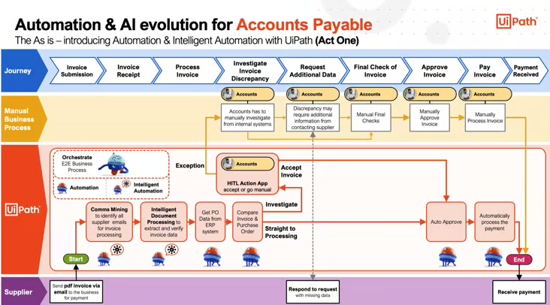
REDESIGNED FROM ORIGINAL COURSE GRAPHIC
Legacy visual reframed · Automated loan risk assessment
Read
Identify the claim, data flow or decision boundary.
Challenge
Ask which assumptions and risks the visual leaves implicit.
Apply
Translate the pattern into a controlled finance workflow.
TGS-2026065050 • Tertiary Infotech Academy Pte Ltd
230

Slide 231
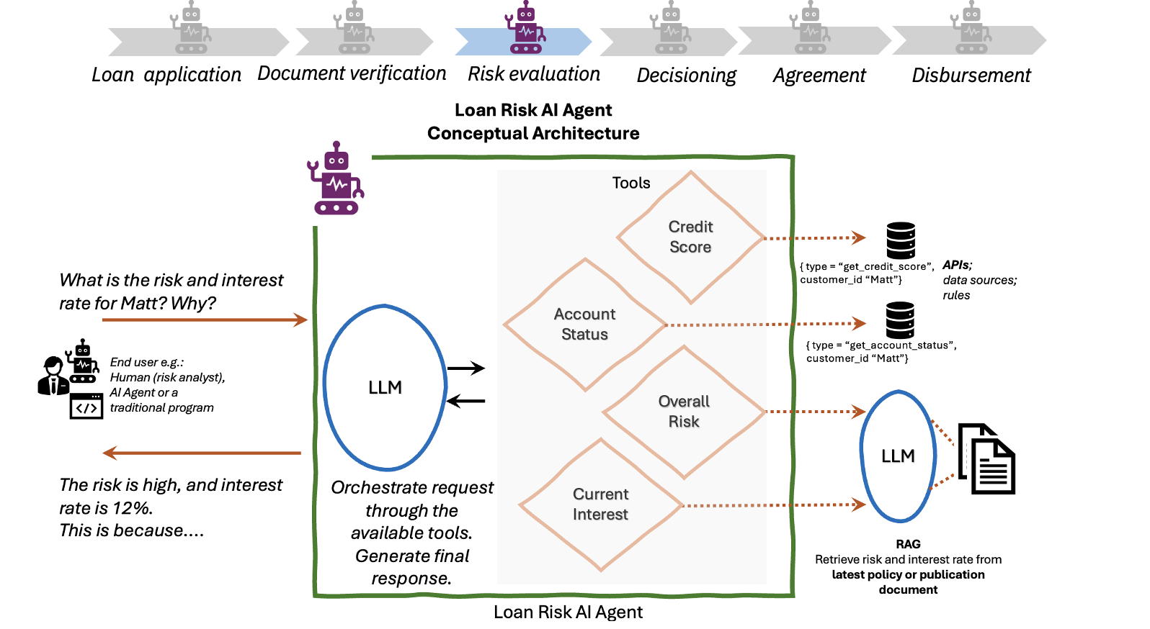
REDESIGNED FROM ORIGINAL COURSE GRAPHIC
Legacy visual reframed · Automated bank reconciliation
Read
Identify the claim, data flow or decision boundary.
Challenge
Ask which assumptions and risks the visual leaves implicit.
Apply
Translate the pattern into a controlled finance workflow.
TGS-2026065050 • Tertiary Infotech Academy Pte Ltd
231

Slide 232
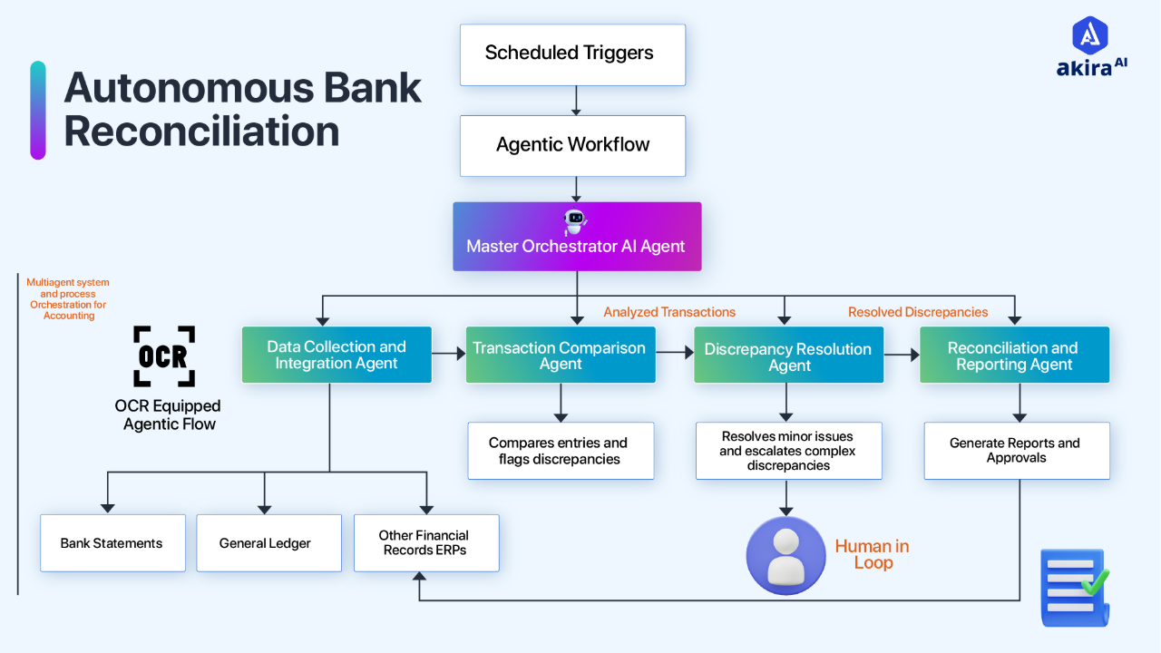
REDESIGNED FROM ORIGINAL COURSE GRAPHIC
Legacy visual reframed · Copilot Studio agent anatomy
Read
Identify the claim, data flow or decision boundary.
Challenge
Ask which assumptions and risks the visual leaves implicit.
Apply
Translate the pattern into a controlled finance workflow.
TGS-2026065050 • Tertiary Infotech Academy Pte Ltd
232

Slide 233
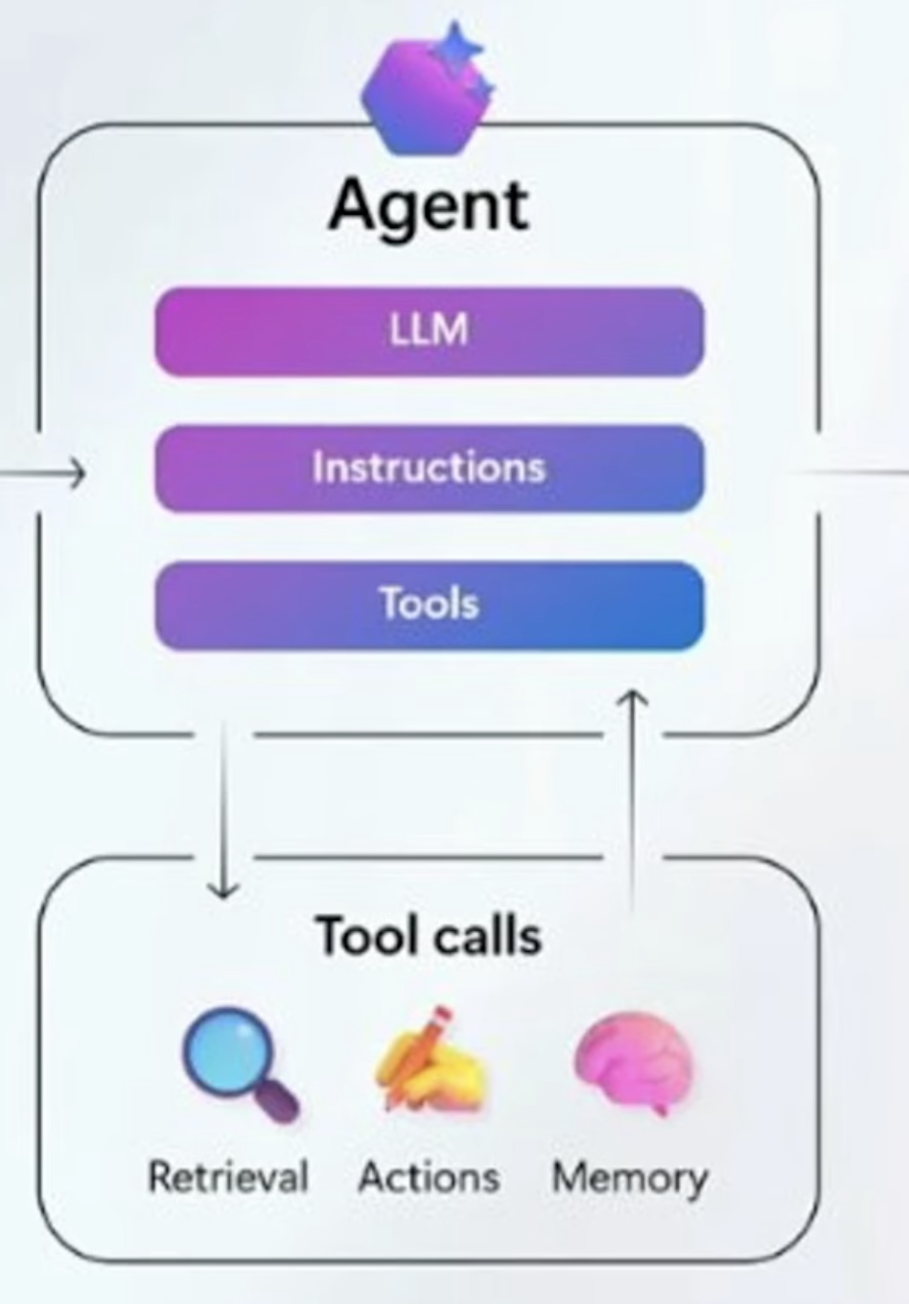
REDESIGNED FROM ORIGINAL COURSE GRAPHIC
Legacy visual reframed · Multi-agent collaboration
Read
Identify the claim, data flow or decision boundary.
Challenge
Ask which assumptions and risks the visual leaves implicit.
Apply
Translate the pattern into a controlled finance workflow.
TGS-2026065050 • Tertiary Infotech Academy Pte Ltd
233

Slide 234
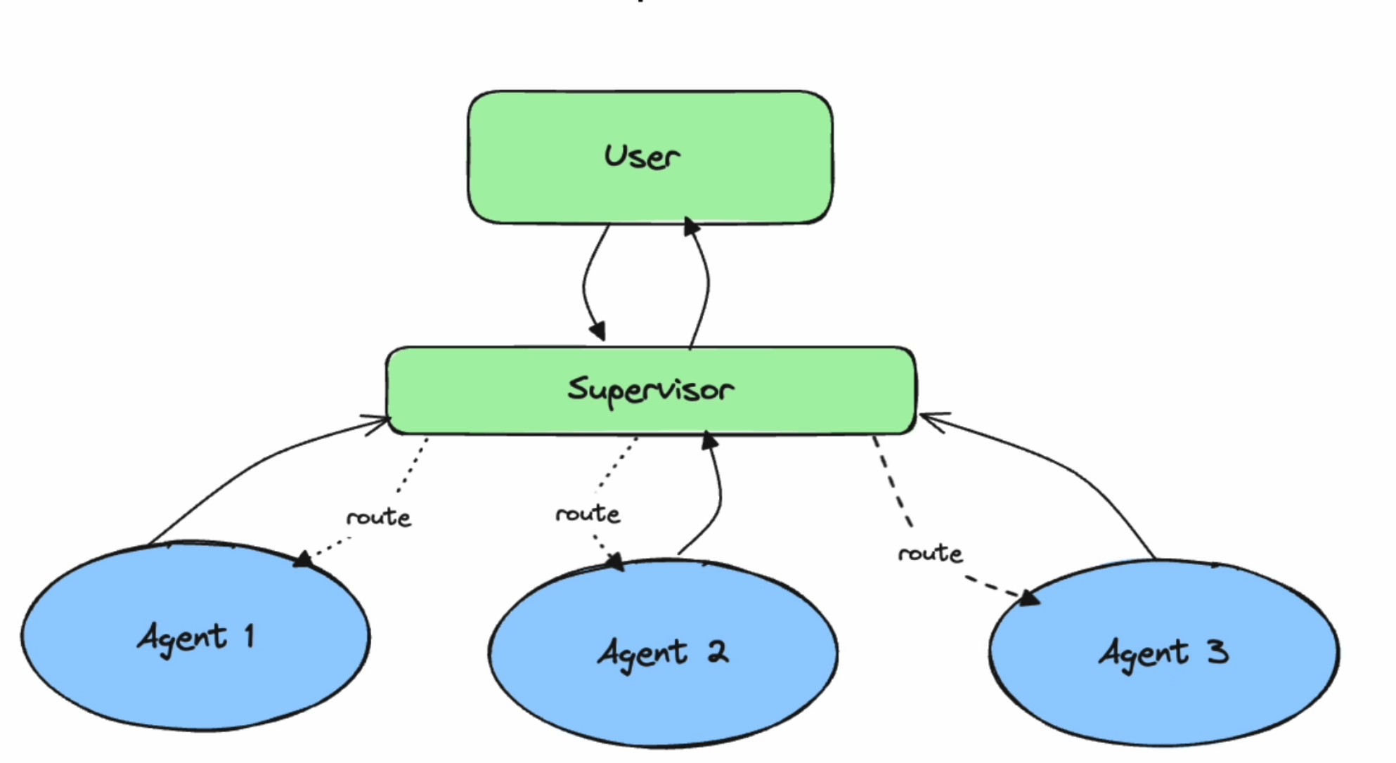
REDESIGNED FROM ORIGINAL COURSE GRAPHIC
Legacy visual reframed · Reconcile data with Finance Agent in Excel
Read
Identify the claim, data flow or decision boundary.
Challenge
Ask which assumptions and risks the visual leaves implicit.
Apply
Translate the pattern into a controlled finance workflow.
TGS-2026065050 • Tertiary Infotech Academy Pte Ltd
234

Slide 235
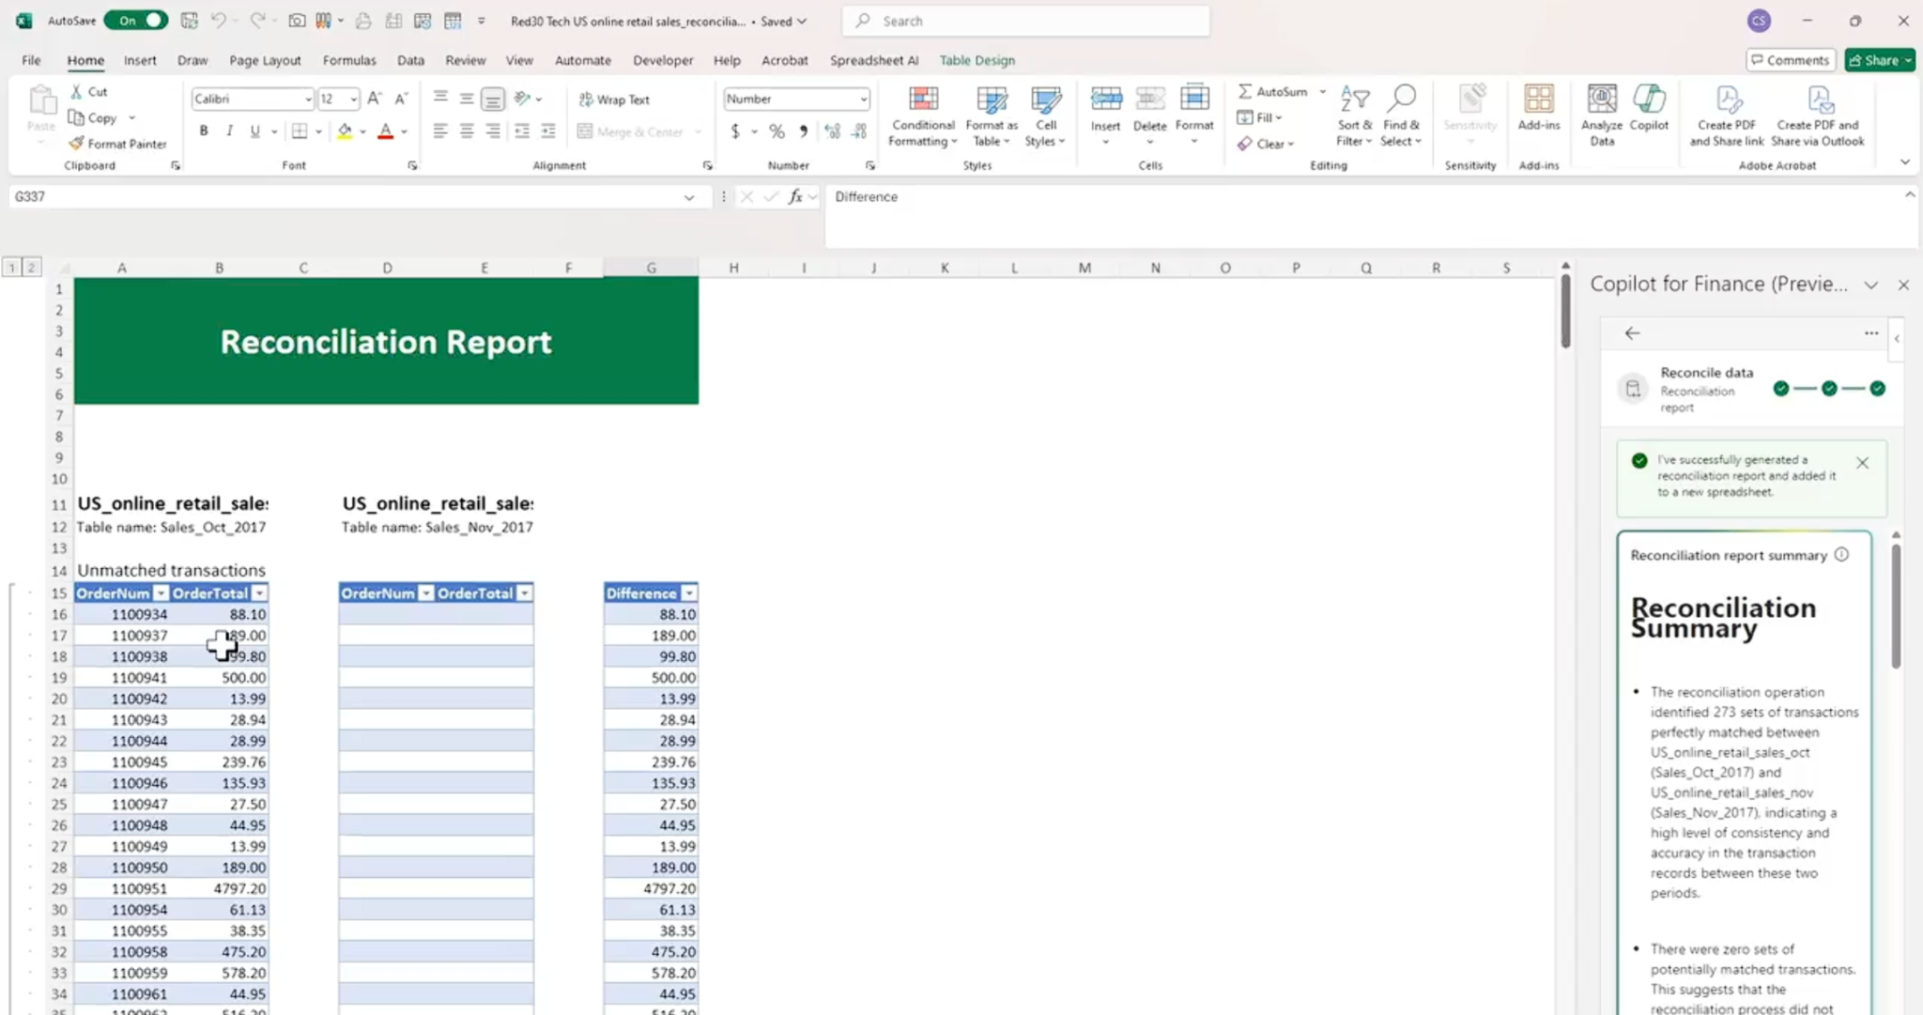
REDESIGNED FROM ORIGINAL COURSE GRAPHIC
Legacy visual reframed · AI and machine-learning applications
Read
Identify the claim, data flow or decision boundary.
Challenge
Ask which assumptions and risks the visual leaves implicit.
Apply
Translate the pattern into a controlled finance workflow.
TGS-2026065050 • Tertiary Infotech Academy Pte Ltd
235

Slide 236

REDESIGNED FROM ORIGINAL COURSE GRAPHIC
Legacy visual reframed · Learning and model behaviour
Read
Identify the claim, data flow or decision boundary.
Challenge
Ask which assumptions and risks the visual leaves implicit.
Apply
Translate the pattern into a controlled finance workflow.
TGS-2026065050 • Tertiary Infotech Academy Pte Ltd
236

Slide 237
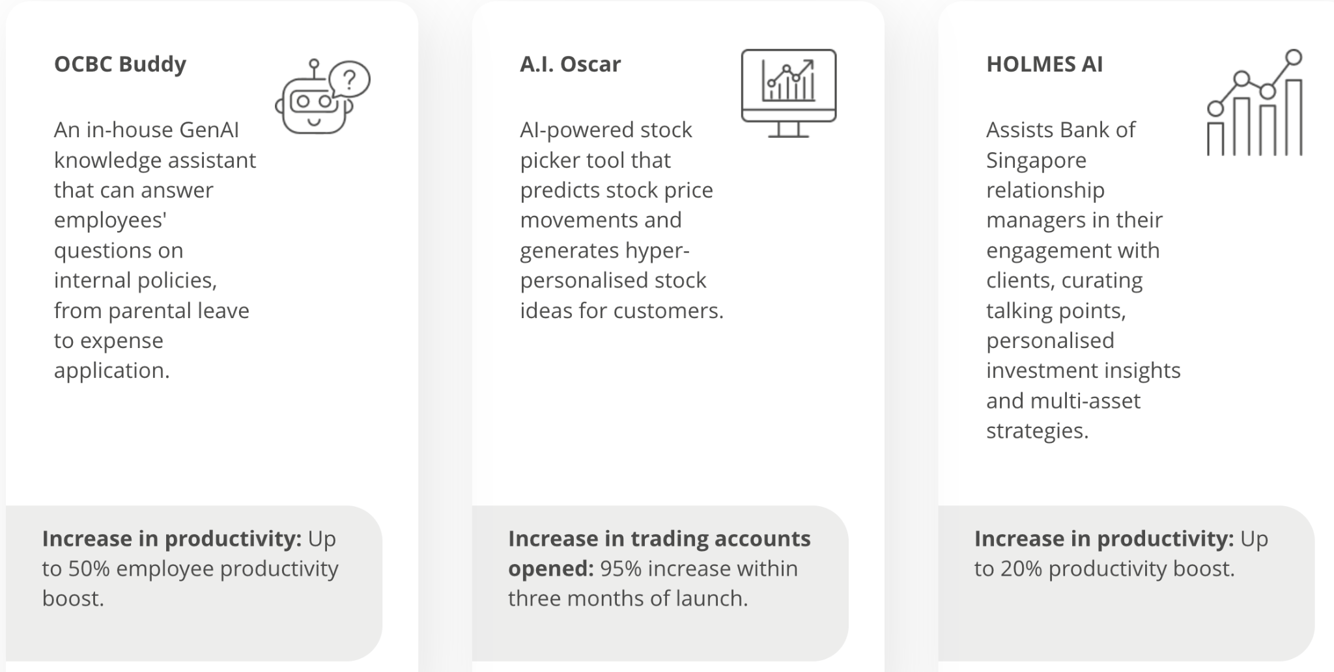
REDESIGNED FROM ORIGINAL COURSE GRAPHIC
Legacy visual reframed · Synthetic fraud scenario
Read
Identify the claim, data flow or decision boundary.
Challenge
Ask which assumptions and risks the visual leaves implicit.
Apply
Translate the pattern into a controlled finance workflow.
TGS-2026065050 • Tertiary Infotech Academy Pte Ltd
237

Slide 238
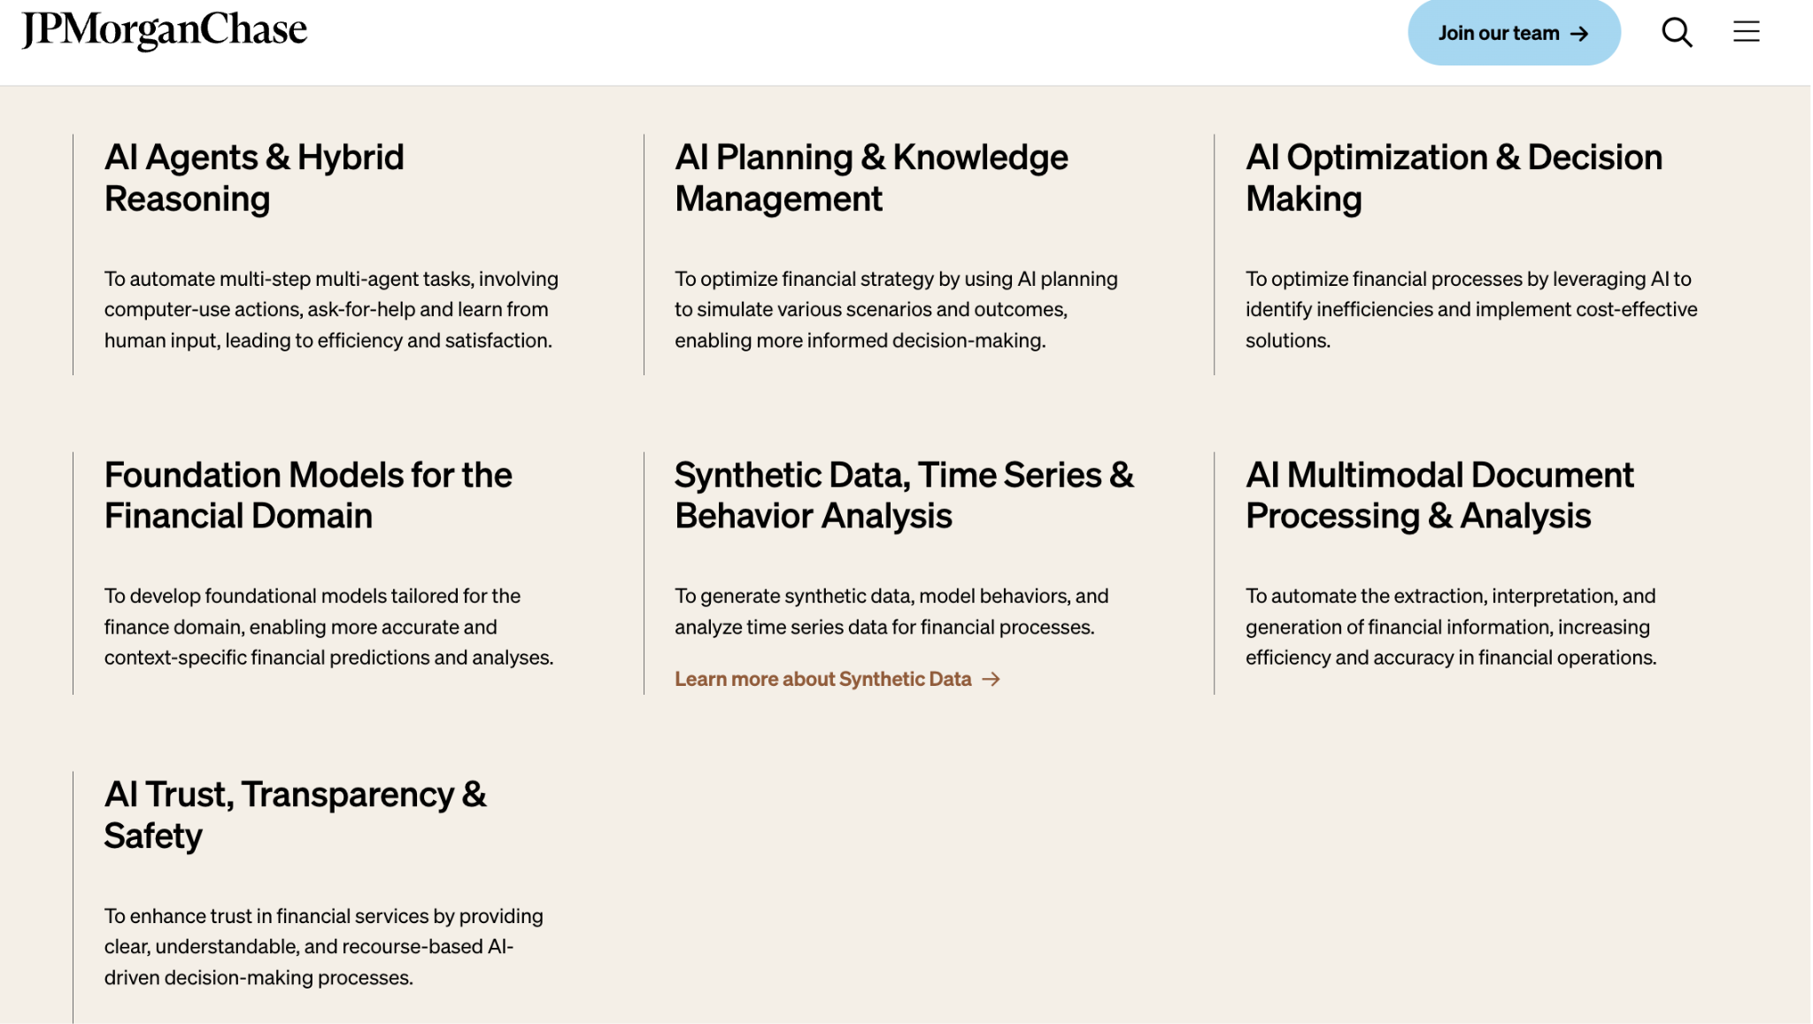
REDESIGNED FROM ORIGINAL COURSE GRAPHIC
Legacy visual reframed · Confusion matrix
Read
Identify the claim, data flow or decision boundary.
Challenge
Ask which assumptions and risks the visual leaves implicit.
Apply
Translate the pattern into a controlled finance workflow.
TGS-2026065050 • Tertiary Infotech Academy Pte Ltd
238

Slide 239

REDESIGNED FROM ORIGINAL COURSE GRAPHIC
Legacy visual reframed · Feature engineering concepts
Read
Identify the claim, data flow or decision boundary.
Challenge
Ask which assumptions and risks the visual leaves implicit.
Apply
Translate the pattern into a controlled finance workflow.
TGS-2026065050 • Tertiary Infotech Academy Pte Ltd
239

Slide 240

REDESIGNED FROM ORIGINAL COURSE GRAPHIC
Legacy visual reframed · AI-generated fraud alerts
Read
Identify the claim, data flow or decision boundary.
Challenge
Ask which assumptions and risks the visual leaves implicit.
Apply
Translate the pattern into a controlled finance workflow.
TGS-2026065050 • Tertiary Infotech Academy Pte Ltd
240

Slide 241
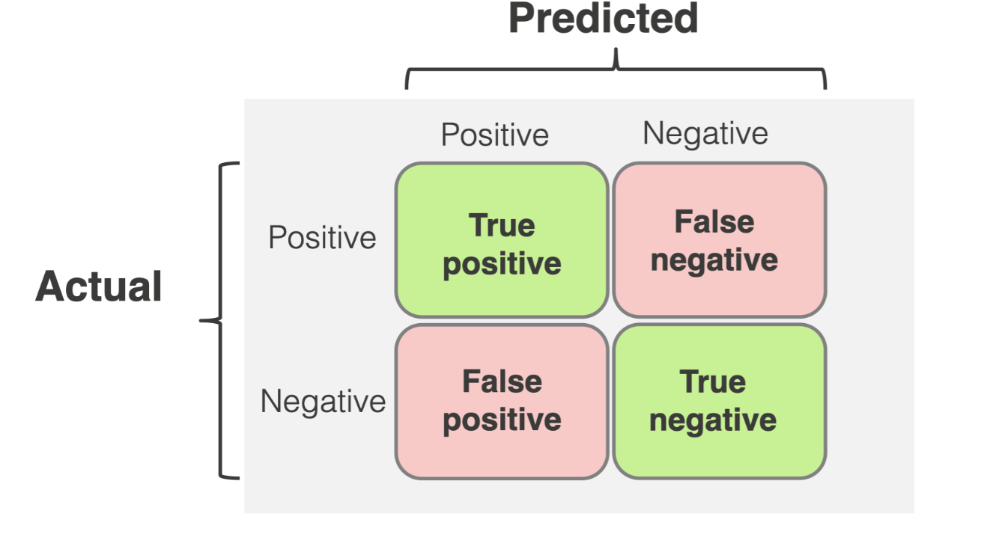
REDESIGNED FROM ORIGINAL COURSE GRAPHIC
Legacy visual reframed · Finance AI operating model
Read
Identify the claim, data flow or decision boundary.
Challenge
Ask which assumptions and risks the visual leaves implicit.
Apply
Translate the pattern into a controlled finance workflow.
TGS-2026065050 • Tertiary Infotech Academy Pte Ltd
241

Slide 242

REDESIGNED FROM ORIGINAL COURSE GRAPHIC
Legacy visual reframed · Finance change-management pattern
Read
Identify the claim, data flow or decision boundary.
Challenge
Ask which assumptions and risks the visual leaves implicit.
Apply
Translate the pattern into a controlled finance workflow.
TGS-2026065050 • Tertiary Infotech Academy Pte Ltd
242

Slide 243

REDESIGNED FROM ORIGINAL COURSE GRAPHIC
Legacy visual reframed · Risk monitoring workflow
Read
Identify the claim, data flow or decision boundary.
Challenge
Ask which assumptions and risks the visual leaves implicit.
Apply
Translate the pattern into a controlled finance workflow.
TGS-2026065050 • Tertiary Infotech Academy Pte Ltd
243

Slide 244
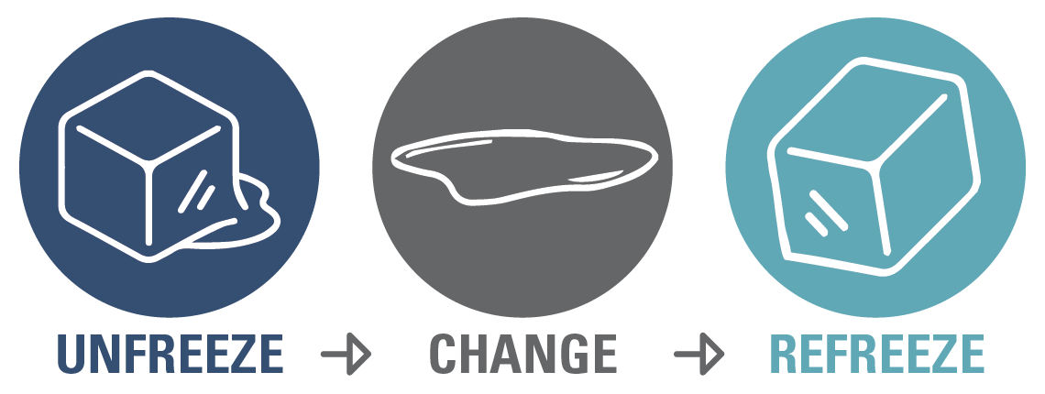
REDESIGNED FROM ORIGINAL COURSE GRAPHIC
Legacy visual reframed · Lewin change framework for finance AI
Read
Identify the claim, data flow or decision boundary.
Challenge
Ask which assumptions and risks the visual leaves implicit.
Apply
Translate the pattern into a controlled finance workflow.
TGS-2026065050 • Tertiary Infotech Academy Pte Ltd
244

Slide 245
TOPIC 1 · EVIDENCE LENS
Decision drill · Accounts payable invoice triage
1
2
3
4
Which source is authoritative?
Which total must reconcile?
Which assumption needs an owner?
What evidence proves completion?
Route invoices, detect missing fields and draft exception notes
Three-way match, duplicate rules, reviewer approval
Lower handling time
Touchless rate · exception ageing
Risk to resolve: Invoice fraud and duplicate payments
TGS-2026065050 • Tertiary Infotech Academy Pte Ltd
245

Slide 246
TOPIC 1 · SECURITY LENS
Decision drill · Cash application
1
2
3
4
Who can invoke it?
What data can leave the boundary?
Which tool can write?
How is misuse detected?
Match remittances to open invoices and explain residuals
Tolerance rules, customer key validation, audit trail
Faster posting
Auto-match rate · unapplied cash
Risk to resolve: Incorrect customer allocation
TGS-2026065050 • Tertiary Infotech Academy Pte Ltd
246

Slide 247
TOPIC 1 · ECONOMICS LENS
Decision drill · Collections prioritisation
1
2
3
4
What baseline cost exists?
Which value KPI changes?
What capacity is consumed?
What stop condition protects cash?
Rank overdue accounts and draft context-aware outreach
Approved templates and human send approval
Improved DSO
Promise-to-pay rate · DSO
Risk to resolve: Unfair or inappropriate communication
TGS-2026065050 • Tertiary Infotech Academy Pte Ltd
247

Slide 248
TOPIC 1 · EVIDENCE LENS
Decision drill · Expense policy assistant
1
2
3
4
Which source is authoritative?
Which total must reconcile?
Which assumption needs an owner?
What evidence proves completion?
Answer employee expense questions from approved policy
Effective-date citations and escalation
Fewer queries
First-contact resolution
Risk to resolve: Outdated or unauthorised advice
TGS-2026065050 • Tertiary Infotech Academy Pte Ltd
248

Slide 249
TOPIC 1 · SECURITY LENS
Decision drill · Regulatory filing summarisation
1
2
3
4
Who can invoke it?
What data can leave the boundary?
Which tool can write?
How is misuse detected?
Extract obligations and draft a review checklist
Primary-source citations and legal review
Faster interpretation
Review hours · citation accuracy
Risk to resolve: Hallucinated requirement
TGS-2026065050 • Tertiary Infotech Academy Pte Ltd
249

Slide 250
TOPIC 1 · ECONOMICS LENS
Decision drill · Earnings-call preparation
1
2
3
4
What baseline cost exists?
Which value KPI changes?
What capacity is consumed?
What stop condition protects cash?
Synthesize performance drivers and likely stakeholder questions
Reconcile to approved results and disclosures
Better preparation
Prep cycle time · corrections
Risk to resolve: Selective or misleading narrative
TGS-2026065050 • Tertiary Infotech Academy Pte Ltd
250

Slide 251
TOPIC 1 · EVIDENCE LENS
Decision drill · Treasury liquidity briefing
1
2
3
4
Which source is authoritative?
Which total must reconcile?
Which assumption needs an owner?
What evidence proves completion?
Summarise cash, facilities and forecast risks
As-of timestamps and source reconciliation
Faster visibility
Forecast error · liquidity headroom
Risk to resolve: Stale balances
TGS-2026065050 • Tertiary Infotech Academy Pte Ltd
251

Slide 252
TOPIC 1 · SECURITY LENS
Decision drill · Credit memo drafting
1
2
3
4
Who can invoke it?
What data can leave the boundary?
Which tool can write?
How is misuse detected?
Assemble borrower facts and analyst rationale
Reason codes, source citations, credit approval
Analyst productivity
Turnaround · override rate
Risk to resolve: Bias and unsupported conclusions
TGS-2026065050 • Tertiary Infotech Academy Pte Ltd
252

Slide 253
TOPIC 1 · ECONOMICS LENS
Decision drill · Insurance claims summarisation
1
2
3
4
What baseline cost exists?
Which value KPI changes?
What capacity is consumed?
What stop condition protects cash?
Summarise documents and flag inconsistencies
Access control, human adjudication, appeal
Faster triage
Cycle time · rework
Risk to resolve: Sensitive-data leakage and wrongful denial
TGS-2026065050 • Tertiary Infotech Academy Pte Ltd
253

Slide 254
TOPIC 1 · EVIDENCE LENS
Decision drill · Financial research synthesis
1
2
3
4
Which source is authoritative?
Which total must reconcile?
Which assumption needs an owner?
What evidence proves completion?
Summarise filings, transcripts and macro evidence
Citations, as-of dates, restricted recommendation scope
Broader coverage
Source coverage · correction rate
Risk to resolve: Unverified market claims
TGS-2026065050 • Tertiary Infotech Academy Pte Ltd
254

Slide 255
TOPIC 2 · SECURITY LENS
Decision drill · Budget build assistant
1
2
3
4
Who can invoke it?
What data can leave the boundary?
Which tool can write?
How is misuse detected?
Create an editable driver-based budget structure
Formula audit and assumption register
Faster model assembly
Build time · formula defects
Risk to resolve: Hidden hard-codes
TGS-2026065050 • Tertiary Infotech Academy Pte Ltd
255

Slide 256
TOPIC 2 · ECONOMICS LENS
Decision drill · Management variance analysis
1
2
3
4
What baseline cost exists?
Which value KPI changes?
What capacity is consumed?
What stop condition protects cash?
Identify material period variances and draft drivers
Materiality rules and evidence-backed narrative
Shorter reporting cycle
Close days · narrative corrections
Risk to resolve: False causality
TGS-2026065050 • Tertiary Infotech Academy Pte Ltd
256

Slide 257
TOPIC 2 · EVIDENCE LENS
Decision drill · Balance-sheet reconciliation
1
2
3
4
Which source is authoritative?
Which total must reconcile?
Which assumption needs an owner?
What evidence proves completion?
Compare account structures and generate reconciliation reports
Deterministic rules, tolerance and reviewer sign-off
Faster close
Auto-match rate · aged items
Risk to resolve: Incorrect matching
TGS-2026065050 • Tertiary Infotech Academy Pte Ltd
257

Slide 258
TOPIC 2 · SECURITY LENS
Decision drill · Intercompany matching
1
2
3
4
Who can invoke it?
What data can leave the boundary?
Which tool can write?
How is misuse detected?
Match reciprocal entries and surface entity or FX differences
Entity scoping and elimination controls
Fewer unresolved items
Unmatched value · ageing
Risk to resolve: Cross-entity access leakage
TGS-2026065050 • Tertiary Infotech Academy Pte Ltd
258

Slide 259
TOPIC 2 · ECONOMICS LENS
Decision drill · Revenue bridge
1
2
3
4
What baseline cost exists?
Which value KPI changes?
What capacity is consumed?
What stop condition protects cash?
Decompose growth into volume, price, mix and FX
Reconciled bridge and driver definitions
Clearer performance story
Unexplained variance
Risk to resolve: Incorrect attribution
TGS-2026065050 • Tertiary Infotech Academy Pte Ltd
259

Slide 260
TOPIC 2 · EVIDENCE LENS
Decision drill · Rolling forecast
1
2
3
4
Which source is authoritative?
Which total must reconcile?
Which assumption needs an owner?
What evidence proves completion?
Extend forecast from recent actuals and operational drivers
Back-testing and scenario review
Faster reforecast
MAPE · bias
Risk to resolve: Overfitting and stale assumptions
TGS-2026065050 • Tertiary Infotech Academy Pte Ltd
260

Slide 261
TOPIC 2 · SECURITY LENS
Decision drill · Headcount cost forecast
1
2
3
4
Who can invoke it?
What data can leave the boundary?
Which tool can write?
How is misuse detected?
Model hires, attrition, salary, bonus and vacancy timing
Aggregate data and restricted payroll access
Better workforce planning
Forecast error · vacancy variance
Risk to resolve: Personal-data exposure
TGS-2026065050 • Tertiary Infotech Academy Pte Ltd
261

Slide 262
TOPIC 2 · ECONOMICS LENS
Decision drill · Working-capital dashboard
1
2
3
4
What baseline cost exists?
Which value KPI changes?
What capacity is consumed?
What stop condition protects cash?
Visualise DSO, DPO, inventory days and cash conversion
Definitions and control totals
Actionable cash view
Cash conversion cycle
Risk to resolve: Metric inconsistency
TGS-2026065050 • Tertiary Infotech Academy Pte Ltd
262

Slide 263
TOPIC 2 · EVIDENCE LENS
Decision drill · Spend anomaly review
1
2
3
4
Which source is authoritative?
Which total must reconcile?
Which assumption needs an owner?
What evidence proves completion?
Highlight unusual vendor, amount or timing patterns
Risk scores as triage only
Leakage reduction
Confirmed exceptions · review load
Risk to resolve: False accusations
TGS-2026065050 • Tertiary Infotech Academy Pte Ltd
263

Slide 264
TOPIC 2 · SECURITY LENS
Decision drill · Board pack production
1
2
3
4
Who can invoke it?
What data can leave the boundary?
Which tool can write?
How is misuse detected?
Assemble charts, narrative and actions from approved workbook
Single approved source and CFO review
Shorter reporting cycle
Cycle time · revisions
Risk to resolve: Disclosure inconsistency
TGS-2026065050 • Tertiary Infotech Academy Pte Ltd
264

Slide 265
TOPIC 3 · ECONOMICS LENS
Decision drill · Internal finance query agent
1
2
3
4
What baseline cost exists?
Which value KPI changes?
What capacity is consumed?
What stop condition protects cash?
Answer process and policy questions with citations
Authentication, source permissions and DLP
Reduced support load
Resolution · escalation
Risk to resolve: Oversharing
TGS-2026065050 • Tertiary Infotech Academy Pte Ltd
265

Slide 266
TOPIC 3 · EVIDENCE LENS
Decision drill · Close orchestration agent
1
2
3
4
Which source is authoritative?
Which total must reconcile?
Which assumption needs an owner?
What evidence proves completion?
Coordinate tasks, owners, evidence and exceptions
Read-only by default and explicit approvals
More predictable close
On-time tasks · reopen rate
Risk to resolve: Unapproved journal or sign-off
TGS-2026065050 • Tertiary Infotech Academy Pte Ltd
266

Slide 267
TOPIC 3 · SECURITY LENS
Decision drill · Collections copilot
1
2
3
4
Who can invoke it?
What data can leave the boundary?
Which tool can write?
How is misuse detected?
Bring ERP context into Outlook and prepare response options
Human approval and communication log
Scalable outreach
DSO · response rate
Risk to resolve: Automated external message risk
TGS-2026065050 • Tertiary Infotech Academy Pte Ltd
267

Slide 268
TOPIC 3 · ECONOMICS LENS
Decision drill · Procure-to-pay exception agent
1
2
3
4
What baseline cost exists?
Which value KPI changes?
What capacity is consumed?
What stop condition protects cash?
Gather missing evidence and route exceptions
Whitelisted actions and amount thresholds
Reduced queue ageing
Resolution time
Risk to resolve: Tool abuse
TGS-2026065050 • Tertiary Infotech Academy Pte Ltd
268

Slide 269
TOPIC 3 · EVIDENCE LENS
Decision drill · Tax research agent
1
2
3
4
Which source is authoritative?
Which total must reconcile?
Which assumption needs an owner?
What evidence proves completion?
Retrieve internal positions and authoritative guidance
Jurisdiction filters, effective dates, expert review
Faster research
Research time · citation quality
Risk to resolve: Outdated or cross-jurisdiction advice
TGS-2026065050 • Tertiary Infotech Academy Pte Ltd
269

Slide 270
TOPIC 3 · SECURITY LENS
Decision drill · Audit evidence assistant
1
2
3
4
Who can invoke it?
What data can leave the boundary?
Which tool can write?
How is misuse detected?
Index, retrieve and summarise evidence for test procedures
Evidence IDs and auditor judgement
Reduced search time
Retrieval precision · gaps
Risk to resolve: Evidence incompleteness
TGS-2026065050 • Tertiary Infotech Academy Pte Ltd
270

Slide 271
TOPIC 3 · ECONOMICS LENS
Decision drill · Disclosure checklist agent
1
2
3
4
What baseline cost exists?
Which value KPI changes?
What capacity is consumed?
What stop condition protects cash?
Map approved disclosures to evidence and owners
Controlled checklist and preparer/reviewer
Fewer omissions
Open items · late changes
Risk to resolve: Wrong reporting basis
TGS-2026065050 • Tertiary Infotech Academy Pte Ltd
271

Slide 272
TOPIC 3 · EVIDENCE LENS
Decision drill · Investment research multi-agent
1
2
3
4
Which source is authoritative?
Which total must reconcile?
Which assumption needs an owner?
What evidence proves completion?
Separate retrieval, financial analysis, risk challenge and writing
Handoff schemas and independent challenge
Traceable analysis
Citation accuracy · disagreement rate
Risk to resolve: Compounding agent errors
TGS-2026065050 • Tertiary Infotech Academy Pte Ltd
272

Slide 273
TOPIC 3 · SECURITY LENS
Decision drill · Customer service banking agent
1
2
3
4
Who can invoke it?
What data can leave the boundary?
Which tool can write?
How is misuse detected?
Answer product and service questions using approved content
Scope limits and human handoff
24/7 support
Containment · complaints
Risk to resolve: Unsuitable advice
TGS-2026065050 • Tertiary Infotech Academy Pte Ltd
273

Slide 274
TOPIC 3 · ECONOMICS LENS
Decision drill · Loan document review
1
2
3
4
What baseline cost exists?
Which value KPI changes?
What capacity is consumed?
What stop condition protects cash?
Extract covenants, conditions and exceptions
Clause-level citations and legal review
Faster review
Review time · missed exceptions
Risk to resolve: Missed clauses
TGS-2026065050 • Tertiary Infotech Academy Pte Ltd
274

Slide 275
TOPIC 4 · EVIDENCE LENS
Decision drill · Card fraud detection
1
2
3
4
Which source is authoritative?
Which total must reconcile?
Which assumption needs an owner?
What evidence proves completion?
Score transactions using behaviour, merchant and device signals
Threshold economics and investigator feedback
Lower fraud loss
Recall · precision · loss
Risk to resolve: False positives and model drift
TGS-2026065050 • Tertiary Infotech Academy Pte Ltd
275

Slide 276
TOPIC 4 · SECURITY LENS
Decision drill · AML investigation summarisation
1
2
3
4
Who can invoke it?
What data can leave the boundary?
Which tool can write?
How is misuse detected?
Assemble transactions, entities and evidence into a case narrative
Evidence links and investigator approval
Faster investigation
Case time · SAR quality
Risk to resolve: Privacy and confirmation bias
TGS-2026065050 • Tertiary Infotech Academy Pte Ltd
276

Slide 277
TOPIC 4 · ECONOMICS LENS
Decision drill · Account takeover detection
1
2
3
4
What baseline cost exists?
Which value KPI changes?
What capacity is consumed?
What stop condition protects cash?
Detect device, location and behavioural anomalies
Step-up verification and risk thresholds
Faster containment
Fraud loss · challenge rate
Risk to resolve: Customer friction
TGS-2026065050 • Tertiary Infotech Academy Pte Ltd
277

Slide 278
TOPIC 4 · EVIDENCE LENS
Decision drill · Synthetic fraud scenario generation
1
2
3
4
Which source is authoritative?
Which total must reconcile?
Which assumption needs an owner?
What evidence proves completion?
Generate rare attack patterns for resilience testing
Domain review and isolated test data
Broader test coverage
Scenario coverage
Risk to resolve: Unrealistic or unsafe scenarios
TGS-2026065050 • Tertiary Infotech Academy Pte Ltd
278

Slide 279
TOPIC 4 · SECURITY LENS
Decision drill · Model documentation copilot
1
2
3
4
Who can invoke it?
What data can leave the boundary?
Which tool can write?
How is misuse detected?
Draft model cards, limitations and monitoring summaries
Required fields and independent validation
Consistent documentation
Documentation defects
Risk to resolve: False completeness
TGS-2026065050 • Tertiary Infotech Academy Pte Ltd
279

Slide 280
TOPIC 4 · ECONOMICS LENS
Decision drill · Policy compliance monitor
1
2
3
4
What baseline cost exists?
Which value KPI changes?
What capacity is consumed?
What stop condition protects cash?
Compare agent configuration with approved control requirements
Configuration inventory and periodic review
Earlier control detection
Control exceptions
Risk to resolve: Blind spots in telemetry
TGS-2026065050 • Tertiary Infotech Academy Pte Ltd
280

Slide 281
TOPIC 4 · EVIDENCE LENS
Decision drill · Prompt-injection test agent
1
2
3
4
Which source is authoritative?
Which total must reconcile?
Which assumption needs an owner?
What evidence proves completion?
Generate and execute adversarial test cases in a sandbox
Isolated environment and no live secrets
Stronger resilience
Attack success rate
Risk to resolve: Unsafe testing against production
TGS-2026065050 • Tertiary Infotech Academy Pte Ltd
281

Slide 282
TOPIC 4 · SECURITY LENS
Decision drill · Vendor AI due diligence
1
2
3
4
Who can invoke it?
What data can leave the boundary?
Which tool can write?
How is misuse detected?
Summarise contracts, controls, data use and concentration risk
Evidence request and accountable approval
Faster review
Open risks · remediation
Risk to resolve: Reliance on vendor claims
TGS-2026065050 • Tertiary Infotech Academy Pte Ltd
282

Slide 283
TOPIC 4 · ECONOMICS LENS
Decision drill · Cyber alert enrichment
1
2
3
4
What baseline cost exists?
Which value KPI changes?
What capacity is consumed?
What stop condition protects cash?
Summarise threat intelligence and affected financial assets
Trusted feeds and tool isolation
Faster response
MTTR · false escalation
Risk to resolve: Poisoned external content
TGS-2026065050 • Tertiary Infotech Academy Pte Ltd
283

Slide 284
TOPIC 4 · EVIDENCE LENS
Decision drill · Fair lending monitoring
1
2
3
4
Which source is authoritative?
Which total must reconcile?
Which assumption needs an owner?
What evidence proves completion?
Test model outcomes and explanations across groups
Governed fairness testing and remediation
Reduced bias risk
Disparity · override rate
Risk to resolve: Sensitive attribute misuse
TGS-2026065050 • Tertiary Infotech Academy Pte Ltd
284

Slide 285
TOPIC 5 · SECURITY LENS
Decision drill · Finance AI use-case portfolio
1
2
3
4
Who can invoke it?
What data can leave the boundary?
Which tool can write?
How is misuse detected?
Score initiatives on value, feasibility, risk and reuse
Stage gates and realised-benefit review
Better investment choices
NPV · adoption · risk tier
Risk to resolve: Optimism bias
TGS-2026065050 • Tertiary Infotech Academy Pte Ltd
285

Slide 286
TOPIC 5 · ECONOMICS LENS
Decision drill · Licence and capacity optimisation
1
2
3
4
What baseline cost exists?
Which value KPI changes?
What capacity is consumed?
What stop condition protects cash?
Track agent usage and right-size licences or message capacity
Service tiers and usage budgets
Lower run cost
Cost per task
Risk to resolve: Under-provisioning critical workflows
TGS-2026065050 • Tertiary Infotech Academy Pte Ltd
286

Slide 287
TOPIC 5 · EVIDENCE LENS
Decision drill · Agent factory
1
2
3
4
Which source is authoritative?
Which total must reconcile?
Which assumption needs an owner?
What evidence proves completion?
Reuse identity, knowledge, tool, evaluation and monitoring patterns
Catalogue, templates and retirement
Faster safe delivery
Lead time · reuse
Risk to resolve: Agent sprawl
TGS-2026065050 • Tertiary Infotech Academy Pte Ltd
287

Slide 288
TOPIC 5 · SECURITY LENS
Decision drill · AI-enabled finance operating model
1
2
3
4
Who can invoke it?
What data can leave the boundary?
Which tool can write?
How is misuse detected?
Define product, control, data and platform ownership
RACI and lifecycle governance
Sustainable scale
Incidents · release lead time
Risk to resolve: Ambiguous accountability
TGS-2026065050 • Tertiary Infotech Academy Pte Ltd
288

Slide 289
TOPIC 5 · ECONOMICS LENS
Decision drill · Legacy process modernisation
1
2
3
4
What baseline cost exists?
Which value KPI changes?
What capacity is consumed?
What stop condition protects cash?
Use agents to bridge old workflows while redesigning the target process
Sunset plan and architecture review
Faster transition
Retired steps · defects
Risk to resolve: Permanent fragile workarounds
TGS-2026065050 • Tertiary Infotech Academy Pte Ltd
289

Slide 290
TOPIC 5 · EVIDENCE LENS
Decision drill · Continuous controls monitoring
1
2
3
4
Which source is authoritative?
Which total must reconcile?
Which assumption needs an owner?
What evidence proves completion?
Monitor control evidence and exceptions across the period
Materiality and owner workflows
Earlier detection
Exception closure
Risk to resolve: Alert fatigue
TGS-2026065050 • Tertiary Infotech Academy Pte Ltd
290

Slide 291
TOPIC 5 · SECURITY LENS
Decision drill · Digital finance coach
1
2
3
4
Who can invoke it?
What data can leave the boundary?
Which tool can write?
How is misuse detected?
Deliver role-based guidance using approved internal learning
Curated knowledge and feedback
Faster adoption
Adoption · competency
Risk to resolve: Incorrect guidance
TGS-2026065050 • Tertiary Infotech Academy Pte Ltd
291

Slide 292
TOPIC 5 · ECONOMICS LENS
Decision drill · AI investment committee pack
1
2
3
4
What baseline cost exists?
Which value KPI changes?
What capacity is consumed?
What stop condition protects cash?
Combine value, risk, cost and readiness evidence for gate decisions
Independent challenge and post-investment review
Disciplined scaling
Benefits realised
Risk to resolve: Metric gaming
TGS-2026065050 • Tertiary Infotech Academy Pte Ltd
292

Slide 293
TOPIC 1 · EVIDENCE LENS
Decision drill · Accounts payable invoice triage
1
2
3
4
Which source is authoritative?
Which total must reconcile?
Which assumption needs an owner?
What evidence proves completion?
Route invoices, detect missing fields and draft exception notes
Three-way match, duplicate rules, reviewer approval
Lower handling time
Touchless rate · exception ageing
Risk to resolve: Invoice fraud and duplicate payments
TGS-2026065050 • Tertiary Infotech Academy Pte Ltd
293

Slide 294
TOPIC 1 · SECURITY LENS
Decision drill · Cash application
1
2
3
4
Who can invoke it?
What data can leave the boundary?
Which tool can write?
How is misuse detected?
Match remittances to open invoices and explain residuals
Tolerance rules, customer key validation, audit trail
Faster posting
Auto-match rate · unapplied cash
Risk to resolve: Incorrect customer allocation
TGS-2026065050 • Tertiary Infotech Academy Pte Ltd
294

Slide 295
TOPIC 1 · ECONOMICS LENS
Decision drill · Collections prioritisation
1
2
3
4
What baseline cost exists?
Which value KPI changes?
What capacity is consumed?
What stop condition protects cash?
Rank overdue accounts and draft context-aware outreach
Approved templates and human send approval
Improved DSO
Promise-to-pay rate · DSO
Risk to resolve: Unfair or inappropriate communication
TGS-2026065050 • Tertiary Infotech Academy Pte Ltd
295

Slide 296
TOPIC 1 · EVIDENCE LENS
Decision drill · Expense policy assistant
1
2
3
4
Which source is authoritative?
Which total must reconcile?
Which assumption needs an owner?
What evidence proves completion?
Answer employee expense questions from approved policy
Effective-date citations and escalation
Fewer queries
First-contact resolution
Risk to resolve: Outdated or unauthorised advice
TGS-2026065050 • Tertiary Infotech Academy Pte Ltd
296

Slide 297
TOPIC 1 · SECURITY LENS
Decision drill · Regulatory filing summarisation
1
2
3
4
Who can invoke it?
What data can leave the boundary?
Which tool can write?
How is misuse detected?
Extract obligations and draft a review checklist
Primary-source citations and legal review
Faster interpretation
Review hours · citation accuracy
Risk to resolve: Hallucinated requirement
TGS-2026065050 • Tertiary Infotech Academy Pte Ltd
297

Slide 298
TOPIC 1 · ECONOMICS LENS
Decision drill · Earnings-call preparation
1
2
3
4
What baseline cost exists?
Which value KPI changes?
What capacity is consumed?
What stop condition protects cash?
Synthesize performance drivers and likely stakeholder questions
Reconcile to approved results and disclosures
Better preparation
Prep cycle time · corrections
Risk to resolve: Selective or misleading narrative
TGS-2026065050 • Tertiary Infotech Academy Pte Ltd
298

Slide 299
TOPIC 1 · EVIDENCE LENS
Decision drill · Treasury liquidity briefing
1
2
3
4
Which source is authoritative?
Which total must reconcile?
Which assumption needs an owner?
What evidence proves completion?
Summarise cash, facilities and forecast risks
As-of timestamps and source reconciliation
Faster visibility
Forecast error · liquidity headroom
Risk to resolve: Stale balances
TGS-2026065050 • Tertiary Infotech Academy Pte Ltd
299

Slide 300
TOPIC 1 · SECURITY LENS
Decision drill · Credit memo drafting
1
2
3
4
Who can invoke it?
What data can leave the boundary?
Which tool can write?
How is misuse detected?
Assemble borrower facts and analyst rationale
Reason codes, source citations, credit approval
Analyst productivity
Turnaround · override rate
Risk to resolve: Bias and unsupported conclusions
TGS-2026065050 • Tertiary Infotech Academy Pte Ltd
300

Slide 301
TOPIC 1 · ECONOMICS LENS
Decision drill · Insurance claims summarisation
1
2
3
4
What baseline cost exists?
Which value KPI changes?
What capacity is consumed?
What stop condition protects cash?
Summarise documents and flag inconsistencies
Access control, human adjudication, appeal
Faster triage
Cycle time · rework
Risk to resolve: Sensitive-data leakage and wrongful denial
TGS-2026065050 • Tertiary Infotech Academy Pte Ltd
301

Slide 302
TOPIC 1 · EVIDENCE LENS
Decision drill · Financial research synthesis
1
2
3
4
Which source is authoritative?
Which total must reconcile?
Which assumption needs an owner?
What evidence proves completion?
Summarise filings, transcripts and macro evidence
Citations, as-of dates, restricted recommendation scope
Broader coverage
Source coverage · correction rate
Risk to resolve: Unverified market claims
TGS-2026065050 • Tertiary Infotech Academy Pte Ltd
302

Slide 303
TOPIC 2 · SECURITY LENS
Decision drill · Budget build assistant
1
2
3
4
Who can invoke it?
What data can leave the boundary?
Which tool can write?
How is misuse detected?
Create an editable driver-based budget structure
Formula audit and assumption register
Faster model assembly
Build time · formula defects
Risk to resolve: Hidden hard-codes
TGS-2026065050 • Tertiary Infotech Academy Pte Ltd
303

Slide 304
OFFICIAL AND PRACTITIONER SOURCES
References and further reading
Course page
Copilot in Excel - Get started
https://www.tertiarycourses.com.sg/casl-generative-ai-for-finance-and-fintech.html
https://support.microsoft.com/en-us/excel/copilot/get-started-with-copilot-in-excel
Finance Agent overview
Variance analysis in Excel
https://learn.microsoft.com/en-us/copilot/finance/welcome
https://learn.microsoft.com/en-us/copilot/finance/variance/analyze-variances
Microsoft finance scenario library
Copilot Studio security and governance
https://adoption.microsoft.com/en-us/scenario-library/finance/
https://learn.microsoft.com/en-us/microsoft-copilot-studio/security-and-governance
Copilot Studio data policies
Copilot Studio secure projects
https://learn.microsoft.com/en-us/microsoft-copilot-studio/admin-data-loss-prevention
https://learn.microsoft.com/en-us/microsoft-copilot-studio/guidance/sec-gov-phase3
TGS-2026065050 • Tertiary Infotech Academy Pte Ltd
304

Slide 305
OFFICIAL AND PRACTITIONER SOURCES
References and further reading
Microsoft Copilot Control System
MAS FEAT principles
https://learn.microsoft.com/en-us/microsoft-365/copilot/copilot-control-system/security-governance
https://www.mas.gov.sg/~/media/MAS/News%20and%20Publications/Monographs%20and%20Information%20Papers/FEAT%20Principles%20Final.pdf
US Treasury AI in Financial Services
US Treasury AI cybersecurity risks
https://home.treasury.gov/system/files/136/Artificial-Intelligence-in-Financial-Services.pdf
https://home.treasury.gov/system/files/136/Managing-Artificial-Intelligence-Specific-Cybersecurity-Risks-In-The-Financial-Services-Sector.pdf
Financial Services AI Risk Management Framework announcement
Databricks finance AI outlook
https://home.treasury.gov/news/press-releases/sb0401
https://www.databricks.com/sites/default/files/2025-02/finance-report-jan-30.pdf
Databricks AI applications in finance
Association for Financial Professionals - AI in finance
https://www.databricks.com/blog/ai-applications-in-finance
https://www.financialprofessionals.org/glossary/ai-in-finance
TGS-2026065050 • Tertiary Infotech Academy Pte Ltd
305

Slide 306
COURSE SYNTHESIS
From copilots to governed finance capability
1
2
3
4
Ground
Analyse
Act
Prove
Use authoritative finance data.
Keep formulas and assumptions inspectable.
Bound tools, thresholds and approvals.
Retain evidence, UAT and monitoring.
Value arrives when evidence changes a controlled decision.
TGS-2026065050 • Tertiary Infotech Academy Pte Ltd
306

